Slide 1

Empowering health by meaningful conversations using Dialogflow
Mitusha Arya
Notes:
Hello everyone, I am Mitusha Arya. A girl who has a name (GOT). I hold a degree in biomedical engineering, now I work primarily on NLP. Today I will be speaking about empowering health by meaningful conversations using dialogflow.

Slide 2
Health
Health is a state of complete physical, mental and social well-being and not merely the absence of disease or infirmity. - WHO

Slide 3
Health
Health is a state of complete physical, mental and social well-being and not merely the absence of disease or infirmity. - WHO

Slide 4
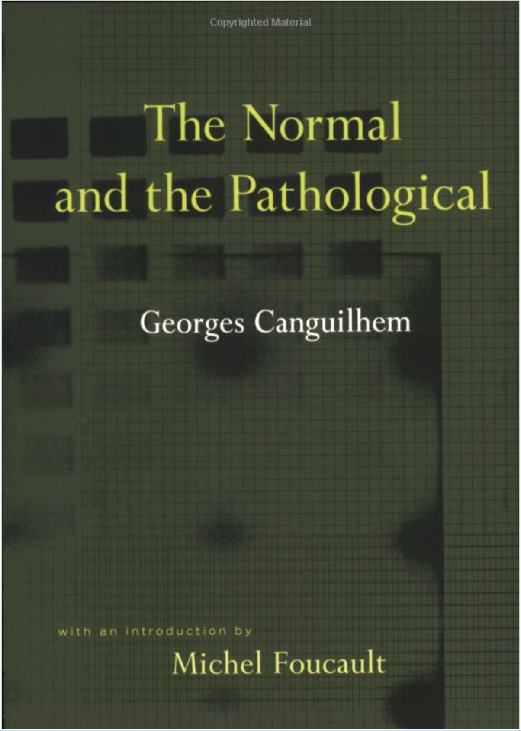
Health
French physician, Georges Canguilhem, saw health not as something defined statistically or mechanistically. Rather, he saw health as the ability to adapt to one's environment.

Slide 5
Health
French physician, Georges Canguilhem, saw health not as something defined statistically or mechanistically. Rather, he saw health as the ability to adapt to one's environment.

Slide 6
Healthcare
We provide care to optimize one’s health.
Notes:
In programmer terms, healthcare is trying to optimize one’s health

Slide 7
Healthcare
We provide care to optimize one’s health.
Notes:
In programmer terms, healthcare is trying to optimize one’s health

Slide 8
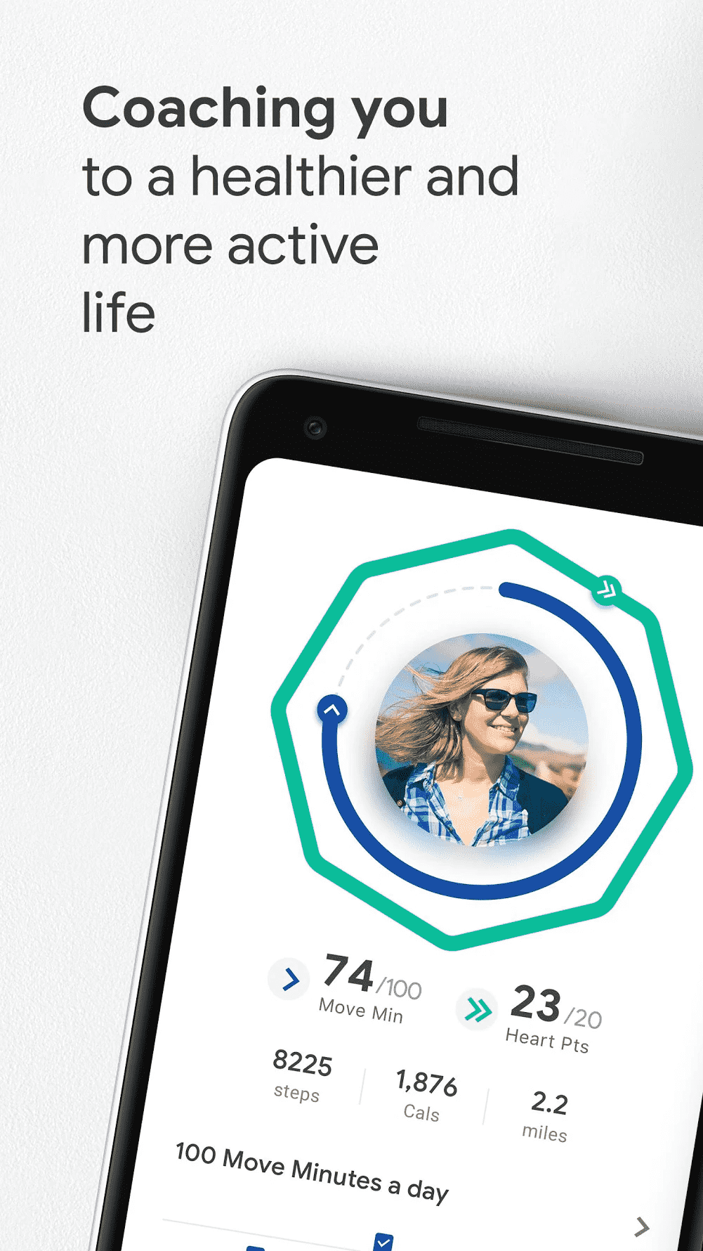
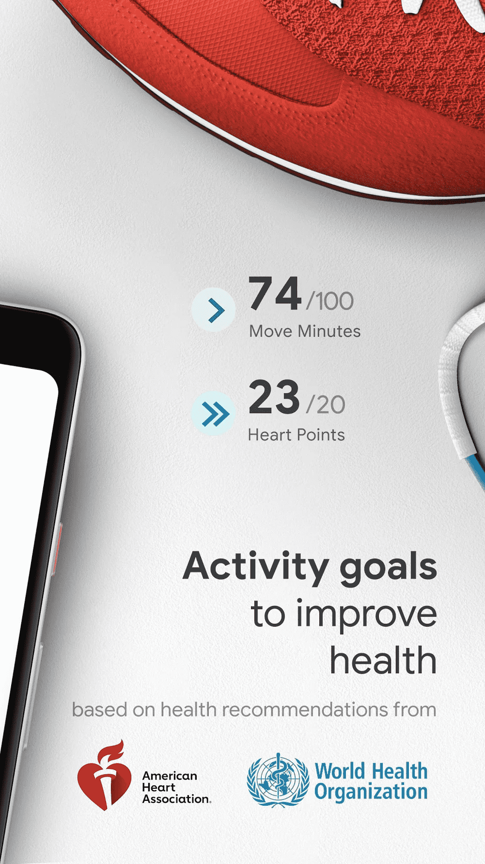
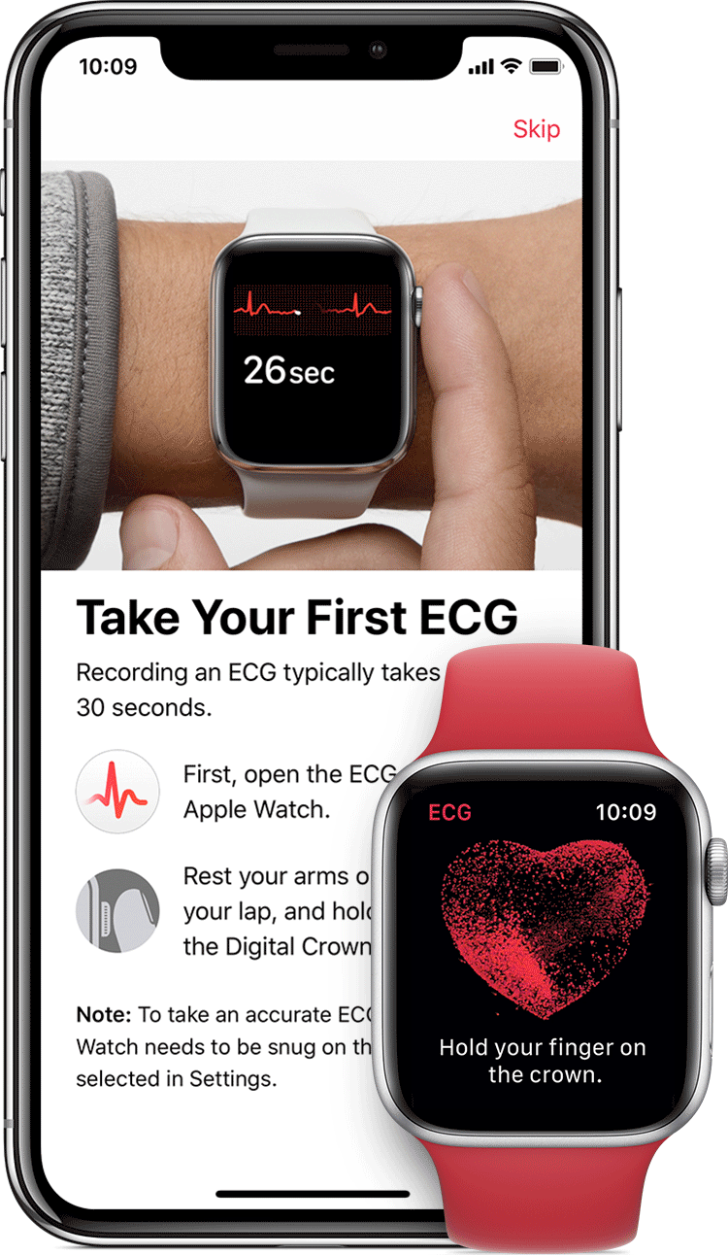

Transformation of healthcare with AI
Notes:
As we are already aware of AI playing an active role in our day to day life. We are powering our lifestyle using data collected by fitness trackers, apps. They motivate us to be more active.

Slide 9
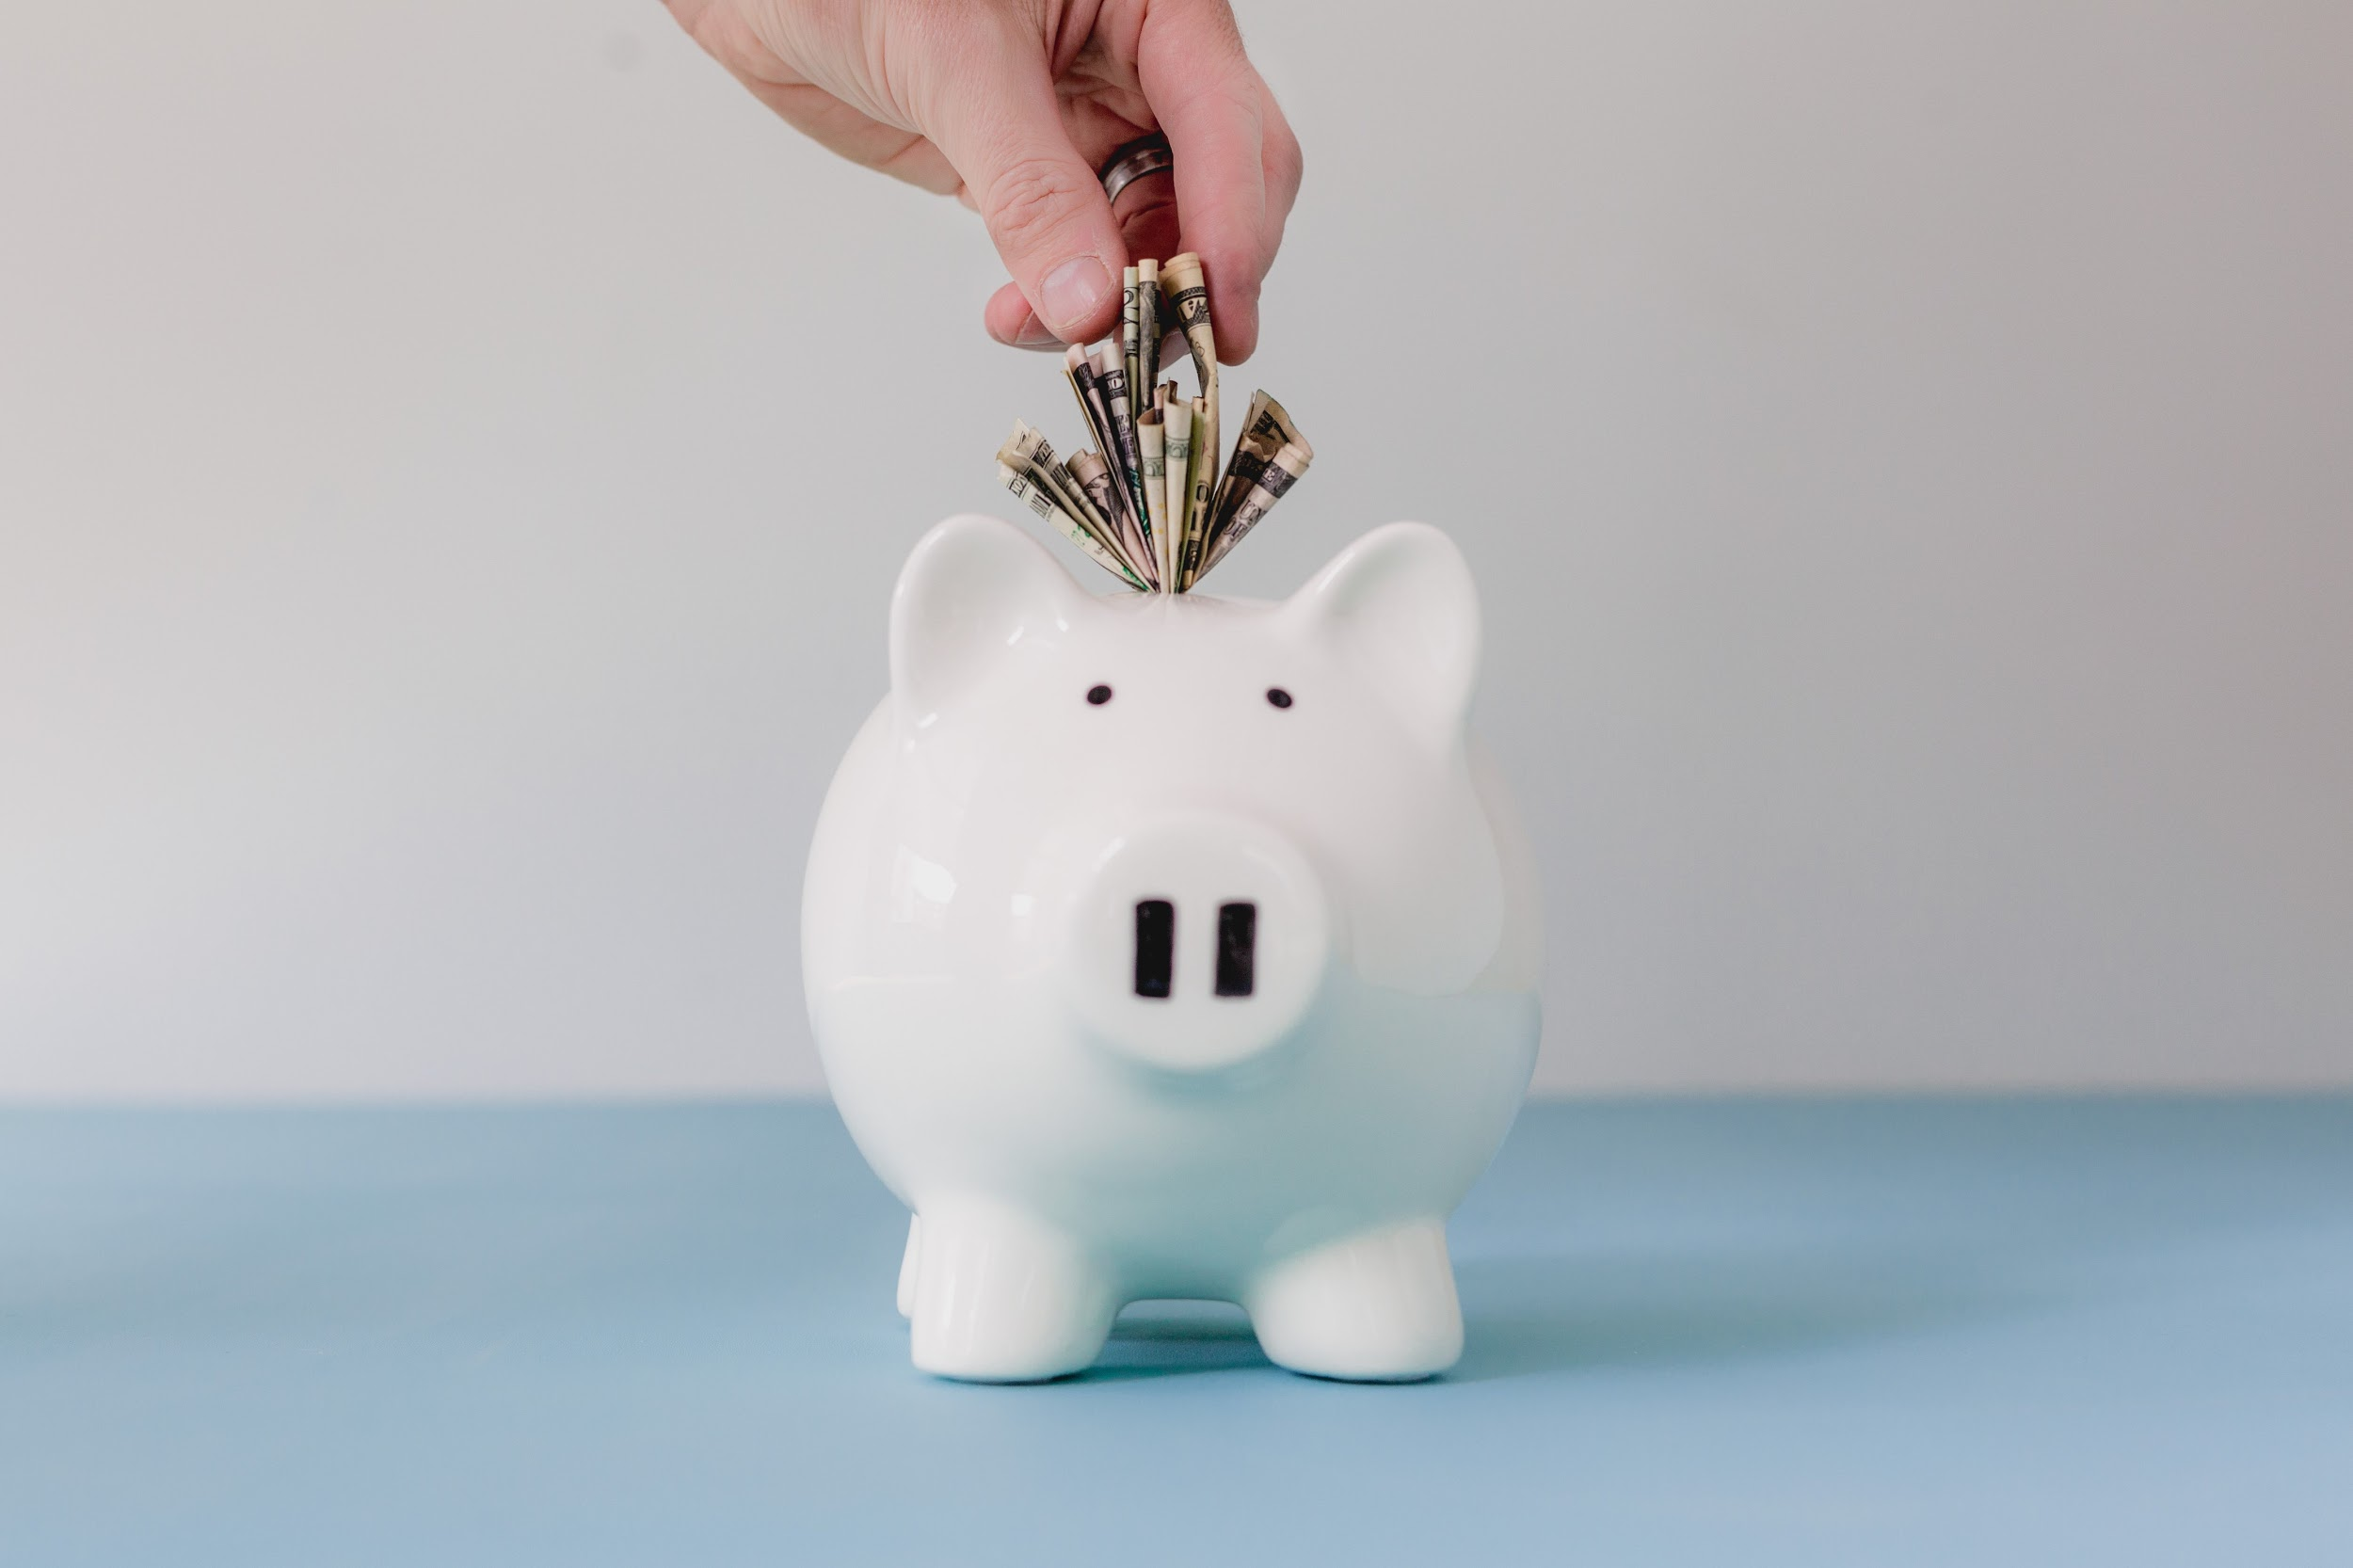
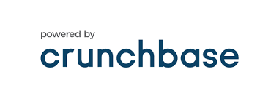
$10M+
Healthy.io
Genenta Science
Anokion
BiovelocITA
& many more ...
Notes:
These are companies that have raised more than 10M$+ in the last year

Slide 10
Conversation is the new UI!
72% of the people who own voice-activated speakers say their devices are often used as a part of their daily routines. - Google

Slide 11
Conversation is the new UI!
72% of the people who own voice-activated speakers say their devices are often used as a part of their daily routines. - Google

Slide 12
Building engaging conversational interfaces with Dialogflow
Notes:
Lets start by building engaging conversations

Slide 13

Dialogflow is a natural language processing (NLP) platform that can be used to build conversational applications and experiences for a company’s customers in various languages and on multiple platforms.

Slide 14
Dialogflow is a natural language processing (NLP) platform that can be used to build conversational applications and experiences for a company’s customers in various languages and on multiple platforms.

Slide 15
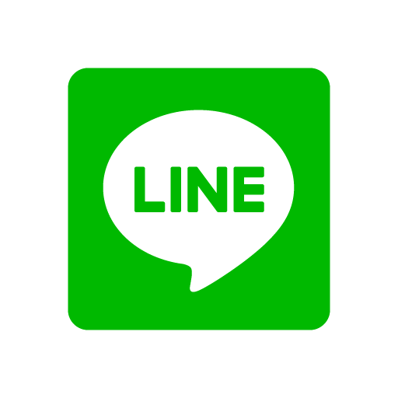
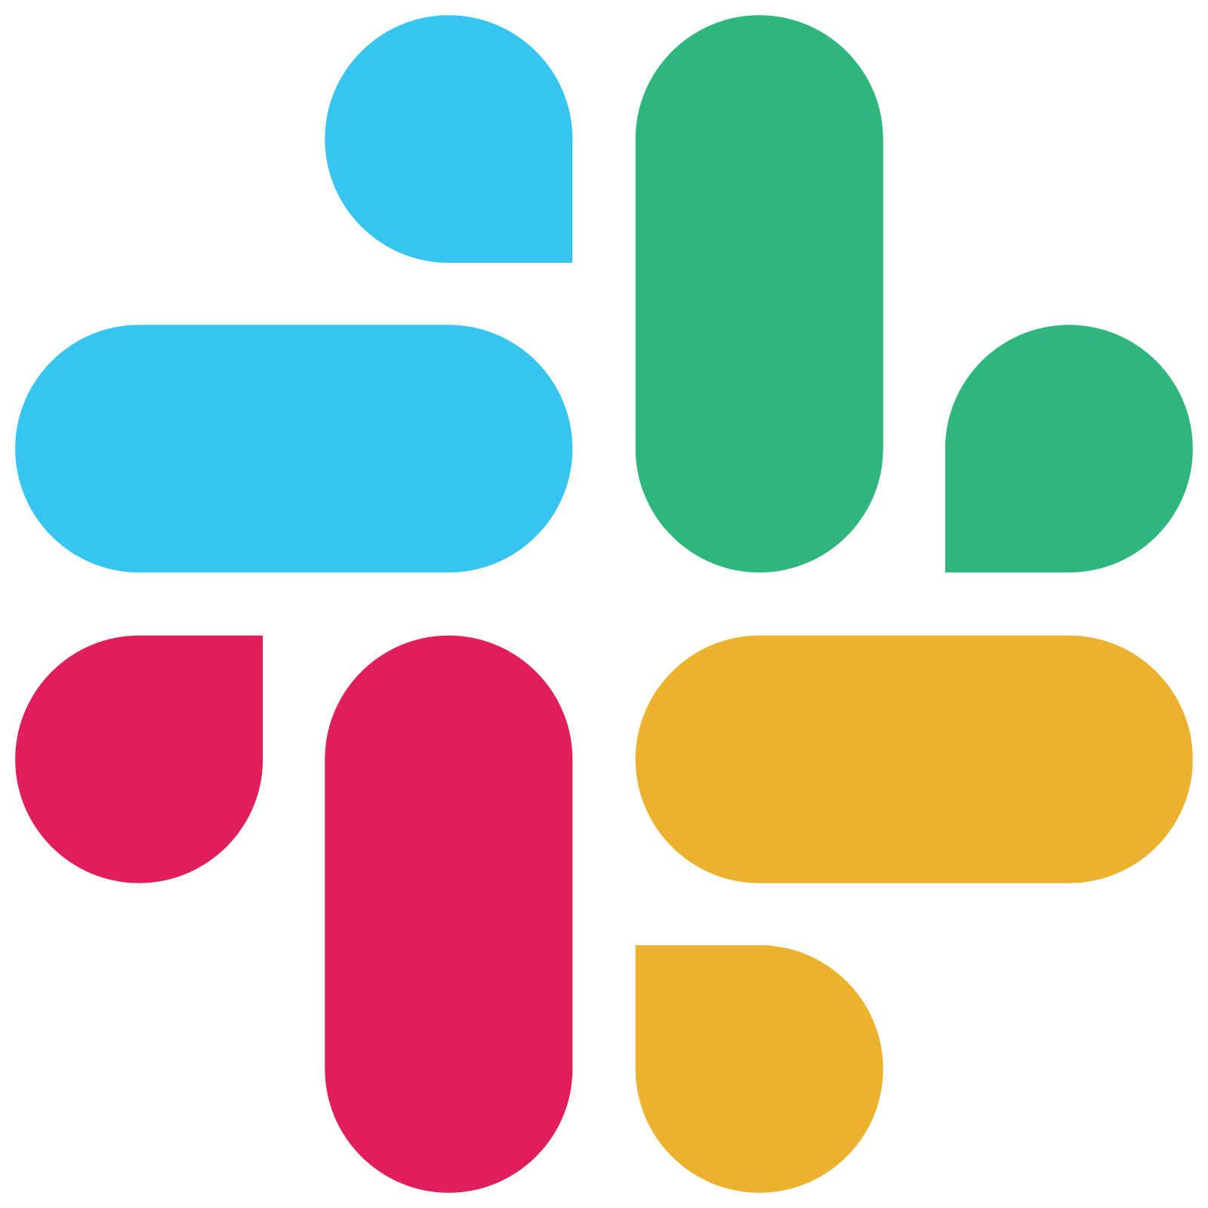


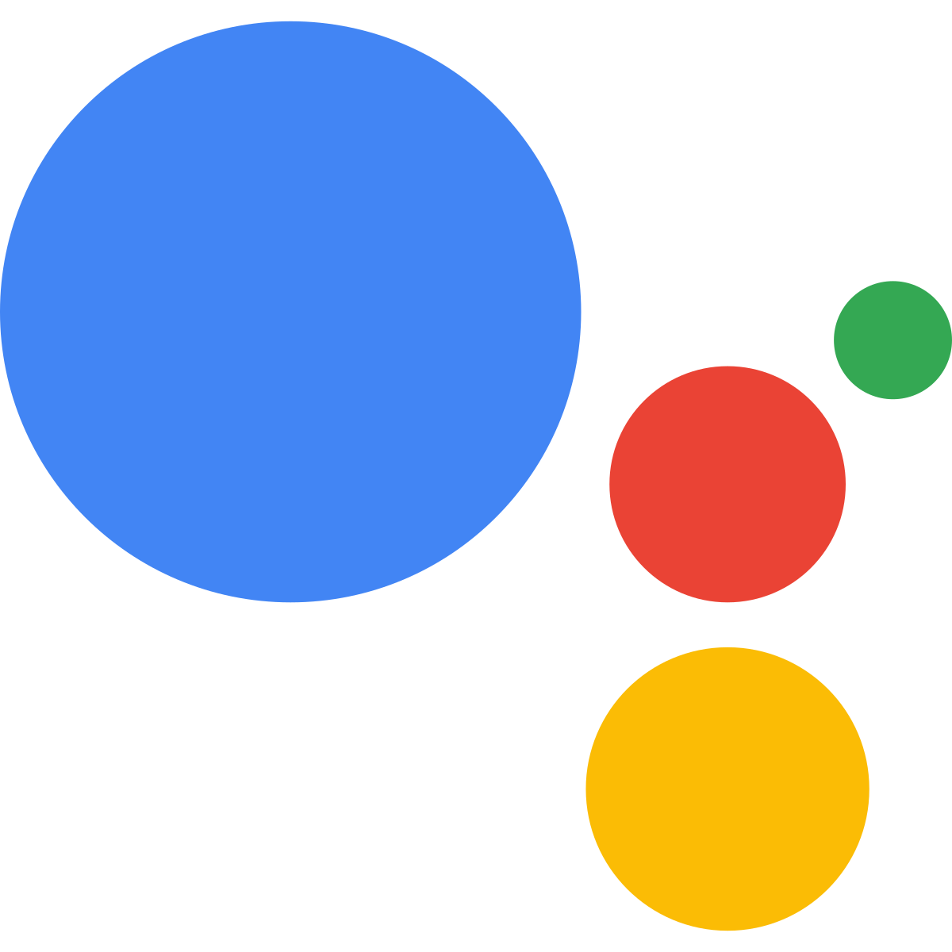


Can be used on multiple platforms

Slide 16
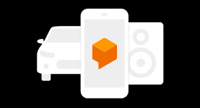
Can be used across devices

Slide 17
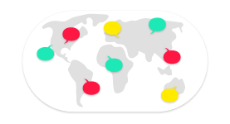
Supports more than 20+ languages

Slide 18
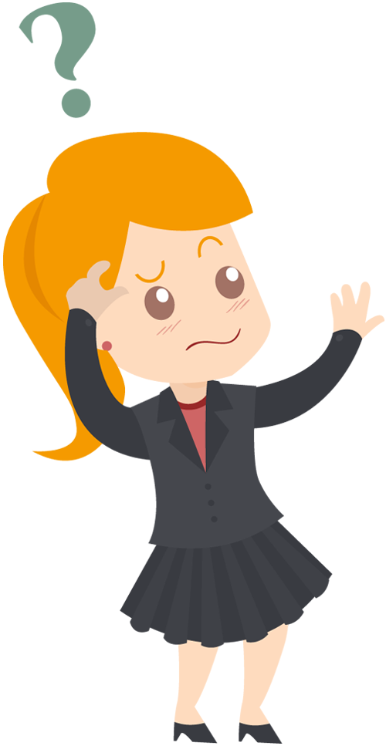
How Dialogflow works?

Slide 19
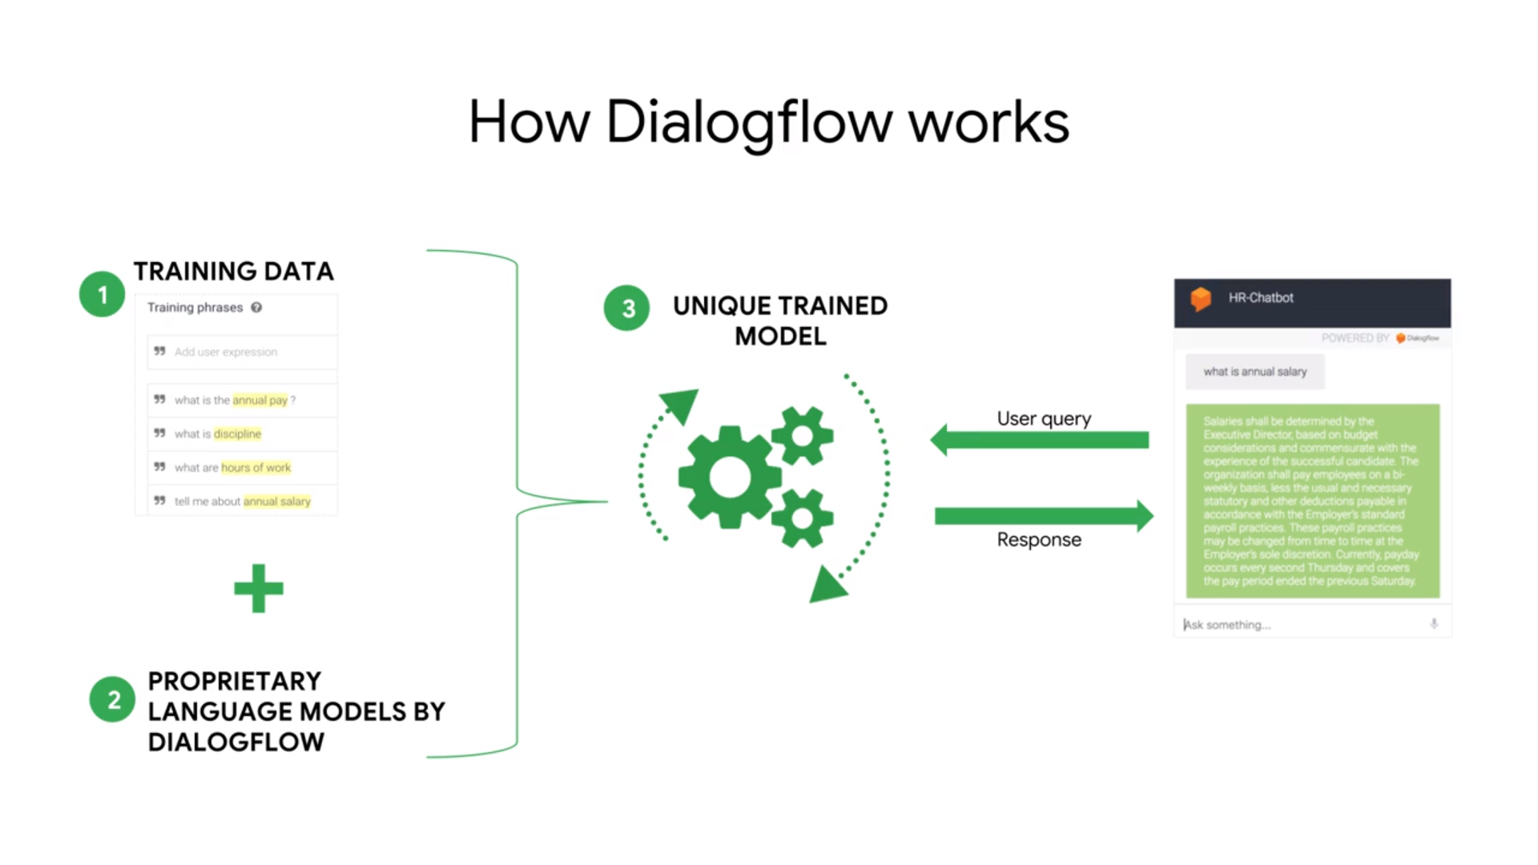
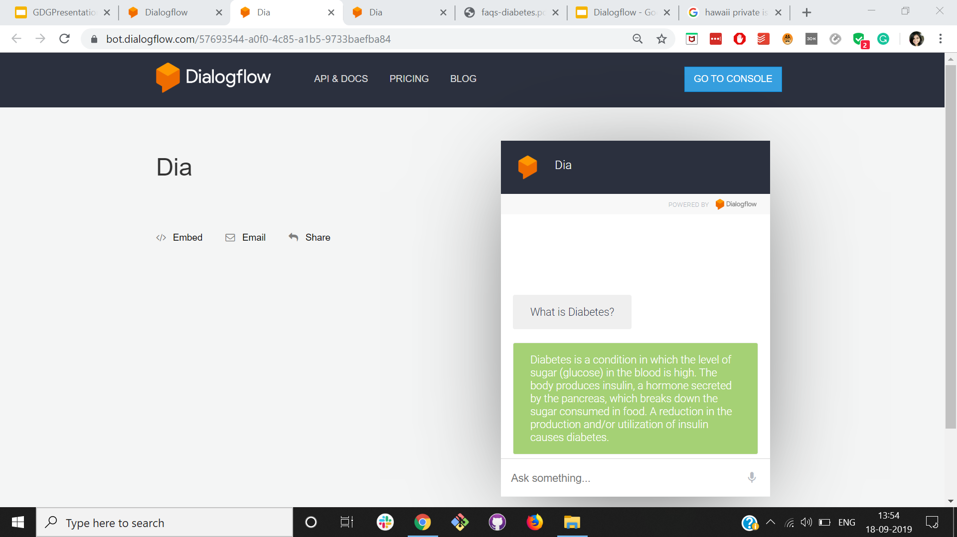
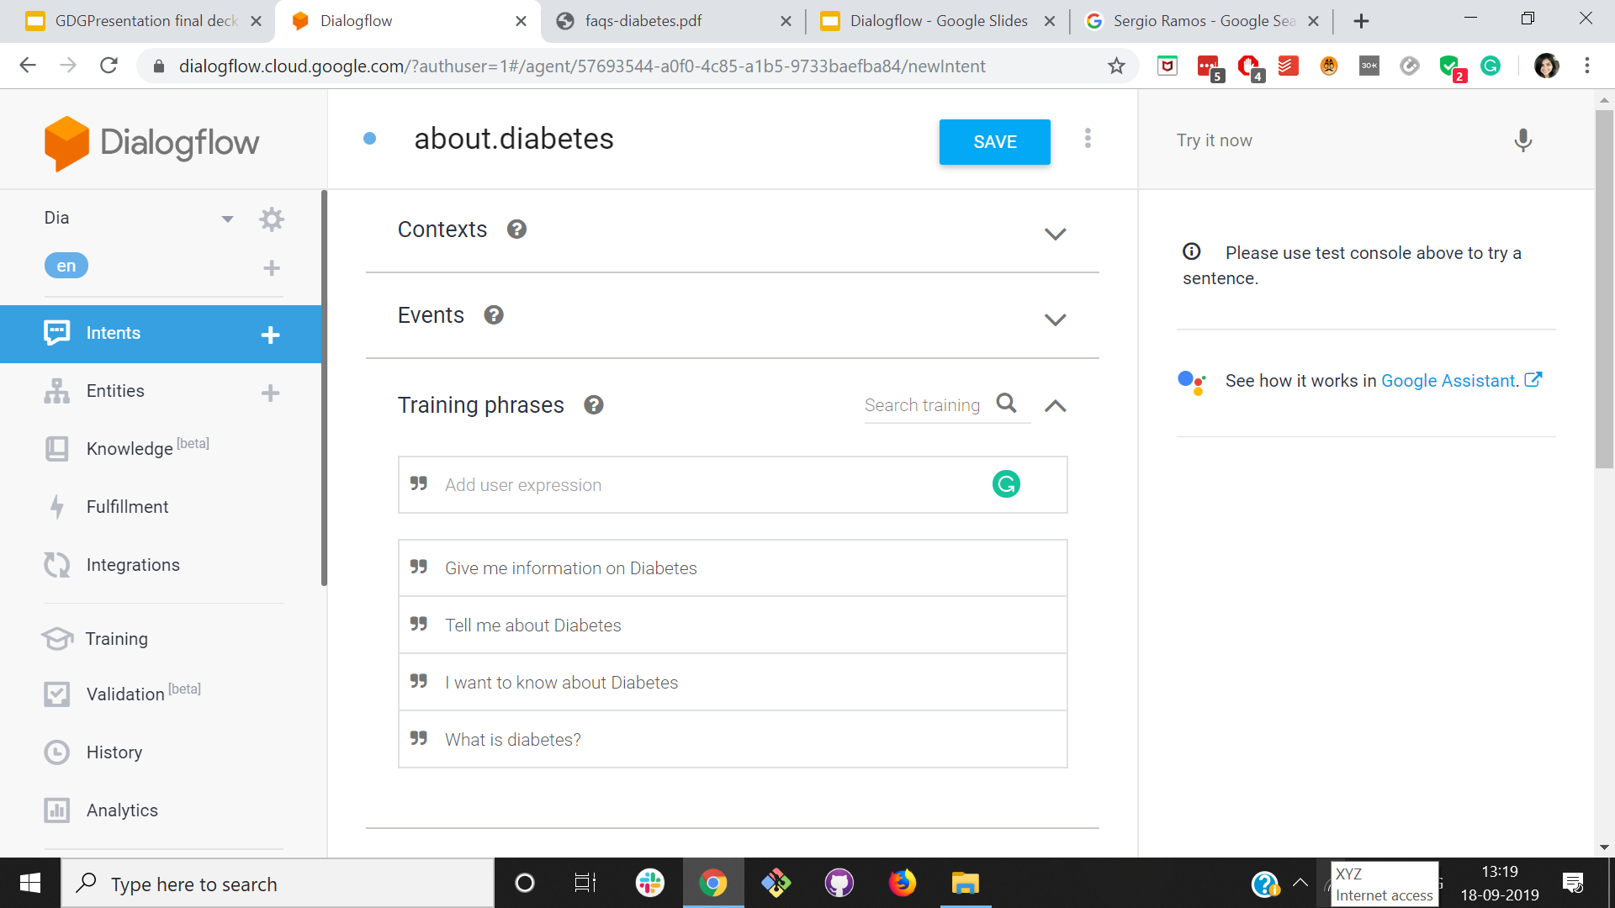
Notes:
This gives you an overview of the entire system built upon dialogflow. We build a unique trained model using the training data and language models by dialogflow. User queries are run across this uniquely trained model and an appropriate response is generated.

Slide 20
Let’s start by building a simple Bot - Dia
Notes:
Dia is bot primarily focused on answering all your diabetes related questions

Slide 21
Queries
 | User query | Intent
1 | What is diabetes?
2 | What is the recommended veg diet for diabetes?
3 | Can I eat non veg food if I have diabetes
4 | Can I drink alcohol if I have diabetes?
5 | What are the steps to a successful talk?
Notes:
We will be extracting intents out of user queries!

Slide 22
Queries
 | User query | Intent
1 | What is diabetes?
2 | What is the recommended veg diet for diabetes?
3 | Can I eat non veg food if I have diabetes
4 | Can I drink alcohol if I have diabetes?
5 | What are the steps to a successful talk?

Slide 23
Queries
 | User query | Intent
1 | What is diabetes? | about.diabetes
2 | What is the recommended veg diet for diabetes? | recommended.veg.diet.diabetes
3 | Can I eat non veg food if I have diabetes | nonveg.food.diabetes
4 | Can I drink alcohol if I have diabetes? | consume.alcohol.diabetes
5 | What are the steps to a successful talk?

Slide 24
Queries
 | User query | Intent
1 | What is diabetes? | about.diabetes
2 | What is the recommended veg diet for diabetes? | recommended.veg.diet.diabetes
3 | Can I eat non veg food if I have diabetes | nonveg.food.diabetes
4 | Can I drink alcohol if I have diabetes? | consume.alcohol.diabetes
5 | What are the steps to a successful talk? | Unknown

Slide 25
Intents are the actions users want to execute.

Slide 26
Intents are the actions users want to execute.

Slide 27
Intents are the actions users want to execute.
It helps the agent determine what the users want.

Slide 28
Intents are the actions users want to execute.
It helps the agent determine what the users want.

Slide 29
User Query:
What is diabetes?

Slide 30
User Query:
What is diabetes?
Intent:
about.diabetes

Slide 31
User Query:
What is diabetes?
Intent:
about.diabetes
Response
Diabetes is a condition in which the level of sugar (glucose) in the blood is high. The body produces insulin, a hormone secreted by the pancreas, which breaks down the sugar consumed in food. A reduction in the production and/or utilization of insulin causes diabetes. If left untreated or uncontrolled, diabetes can lead to serious problems, such as heart disease, stroke, blindness, kidney failure, among others. Some of these may be life threatening.

Slide 32
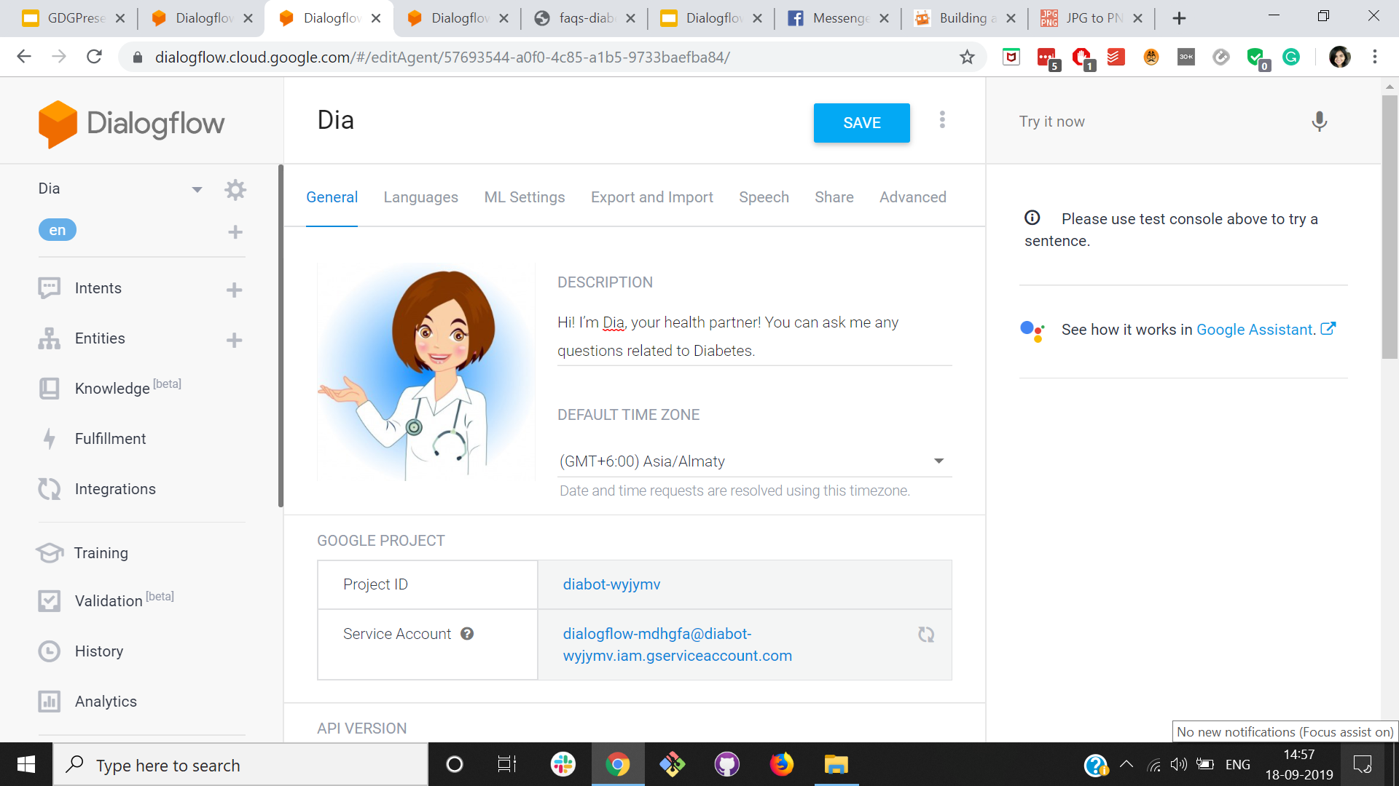
Notes:
Now we will have a look at the entire dialogflow workflow

Slide 33
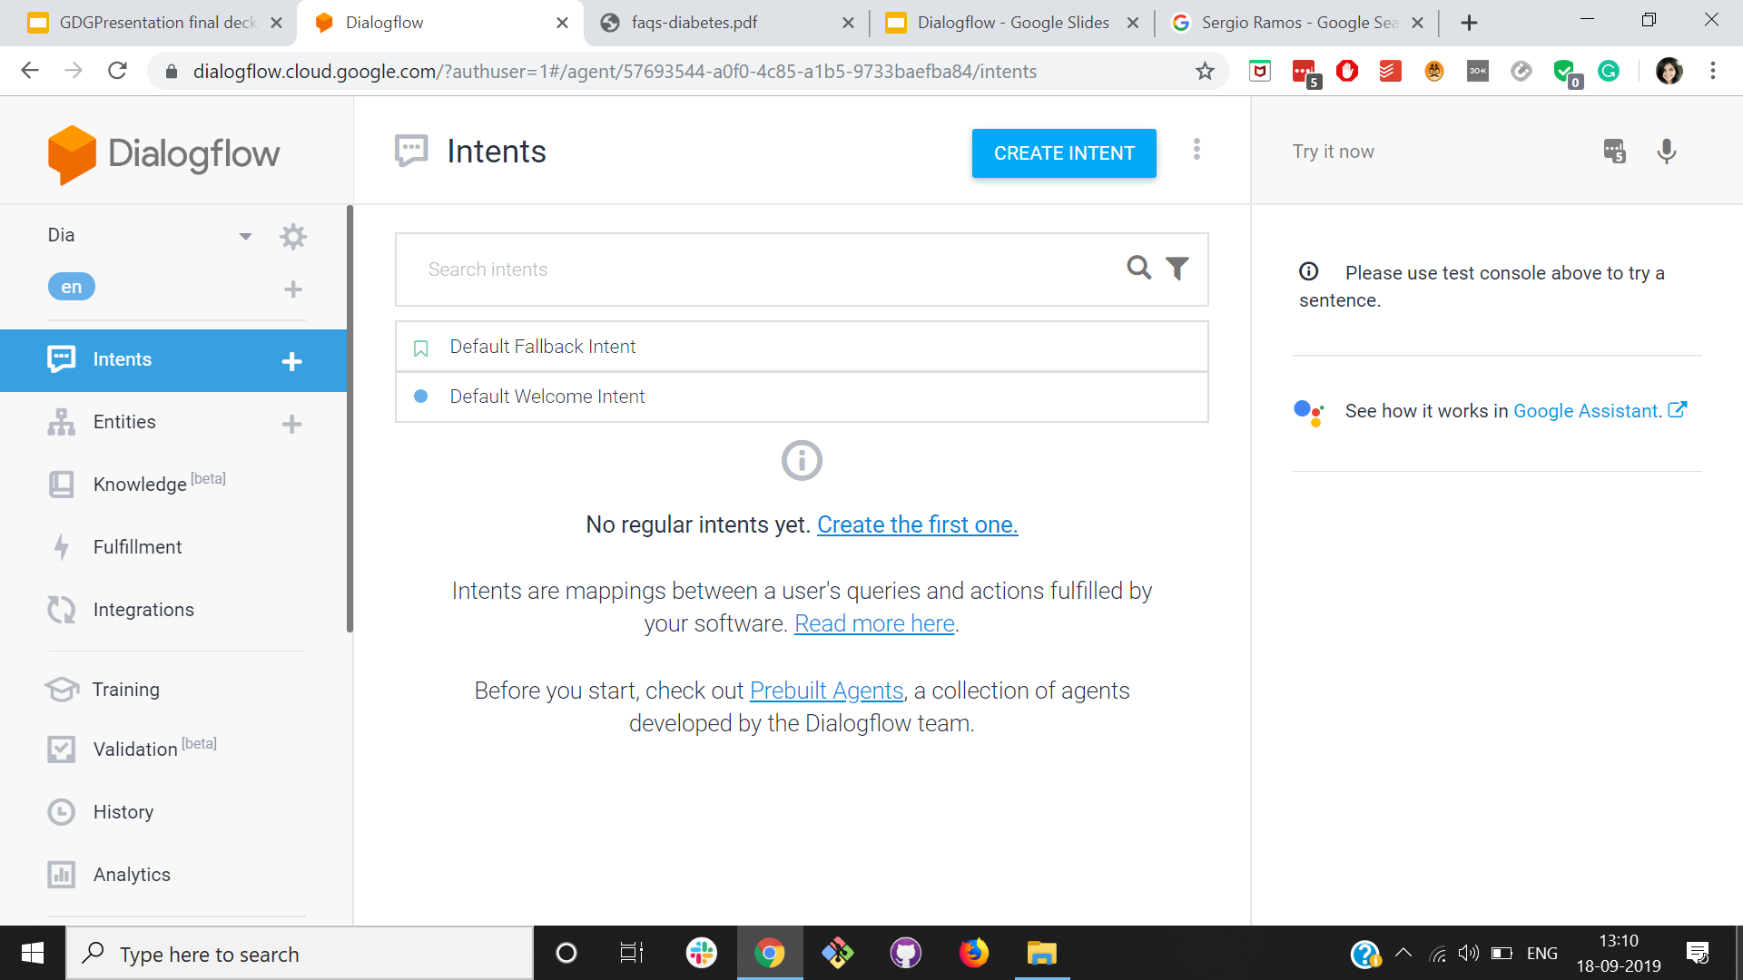

Slide 34
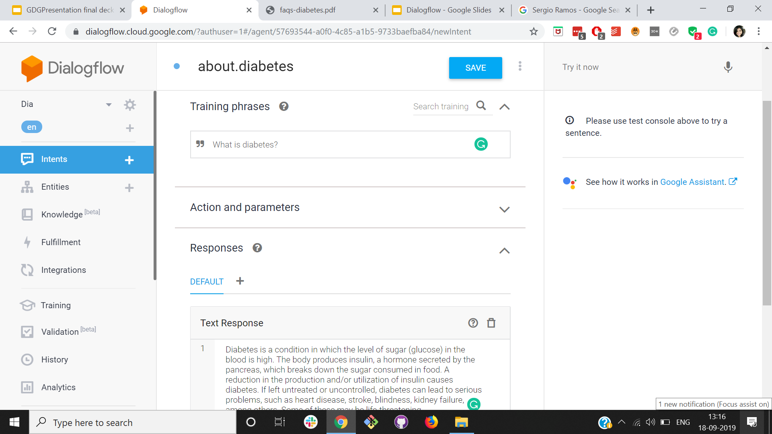

Slide 36
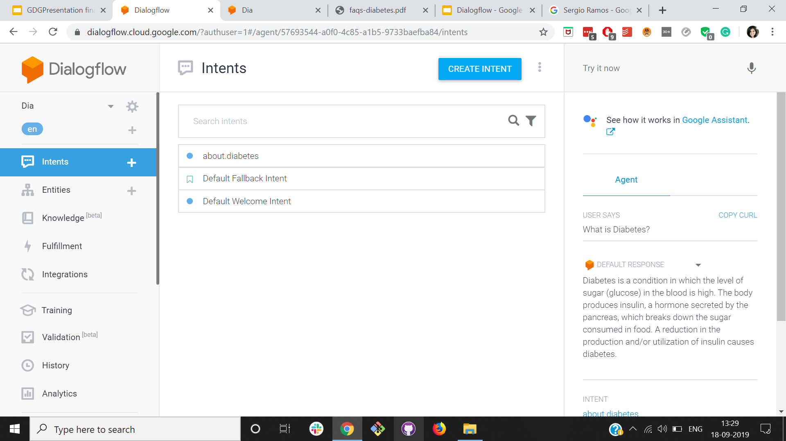
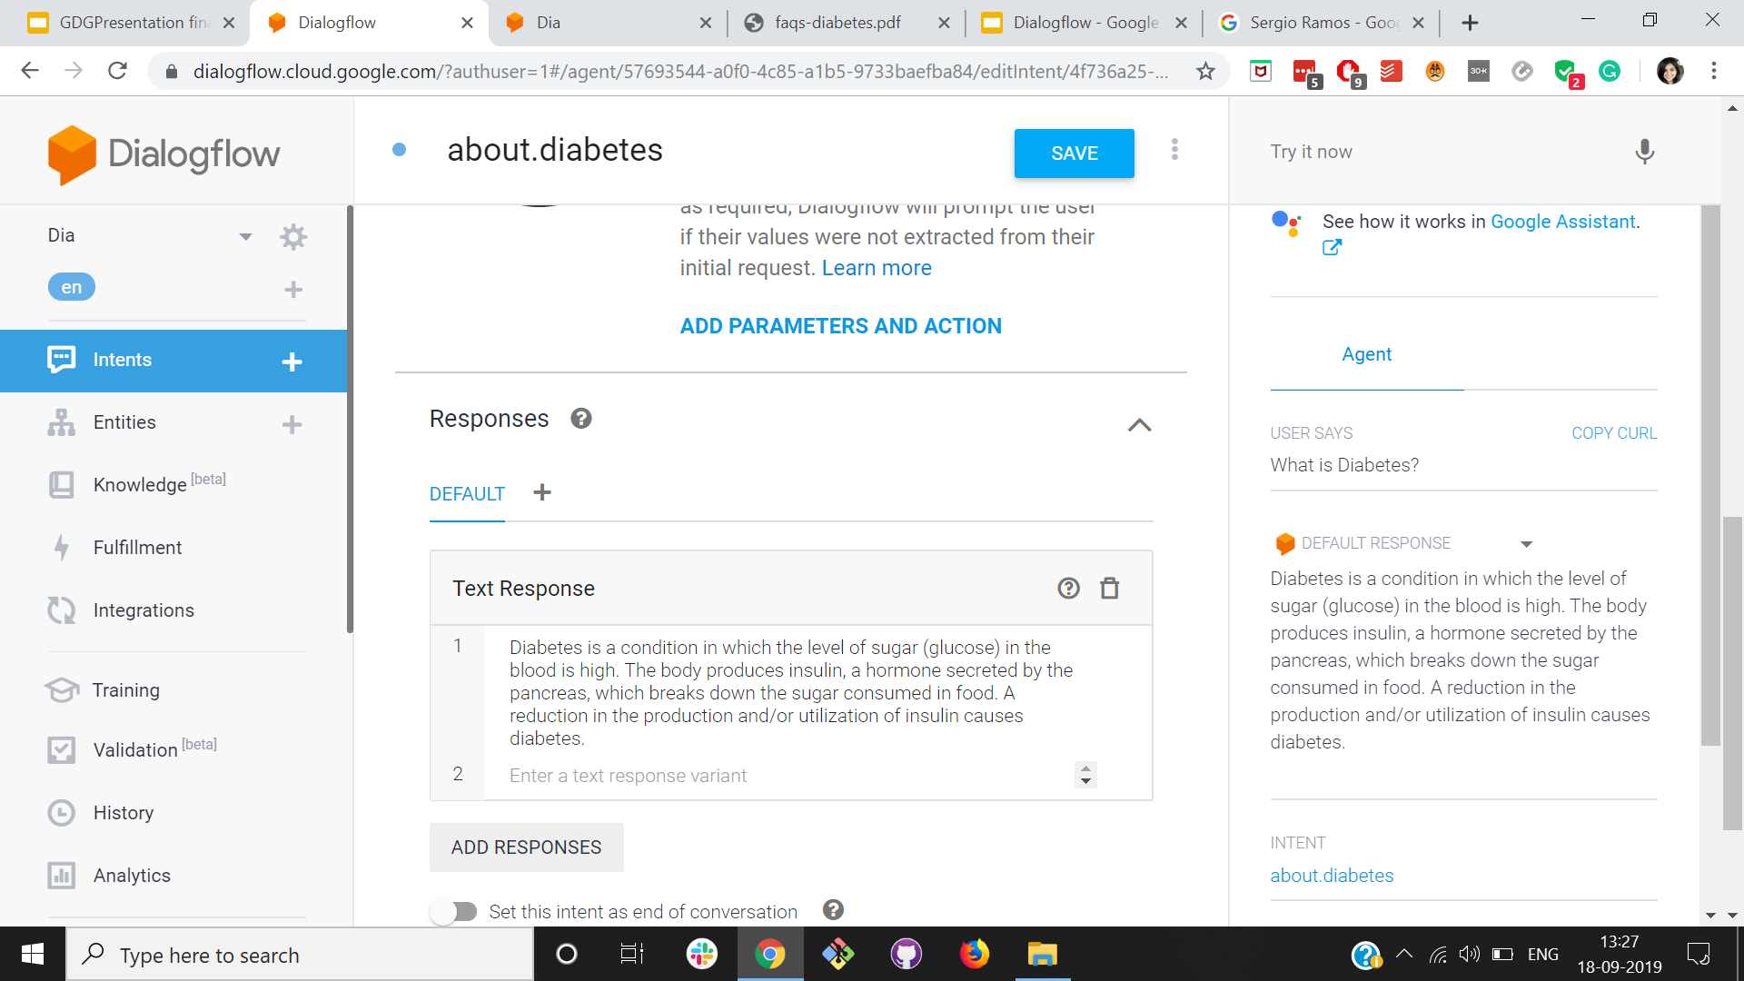

Slide 37
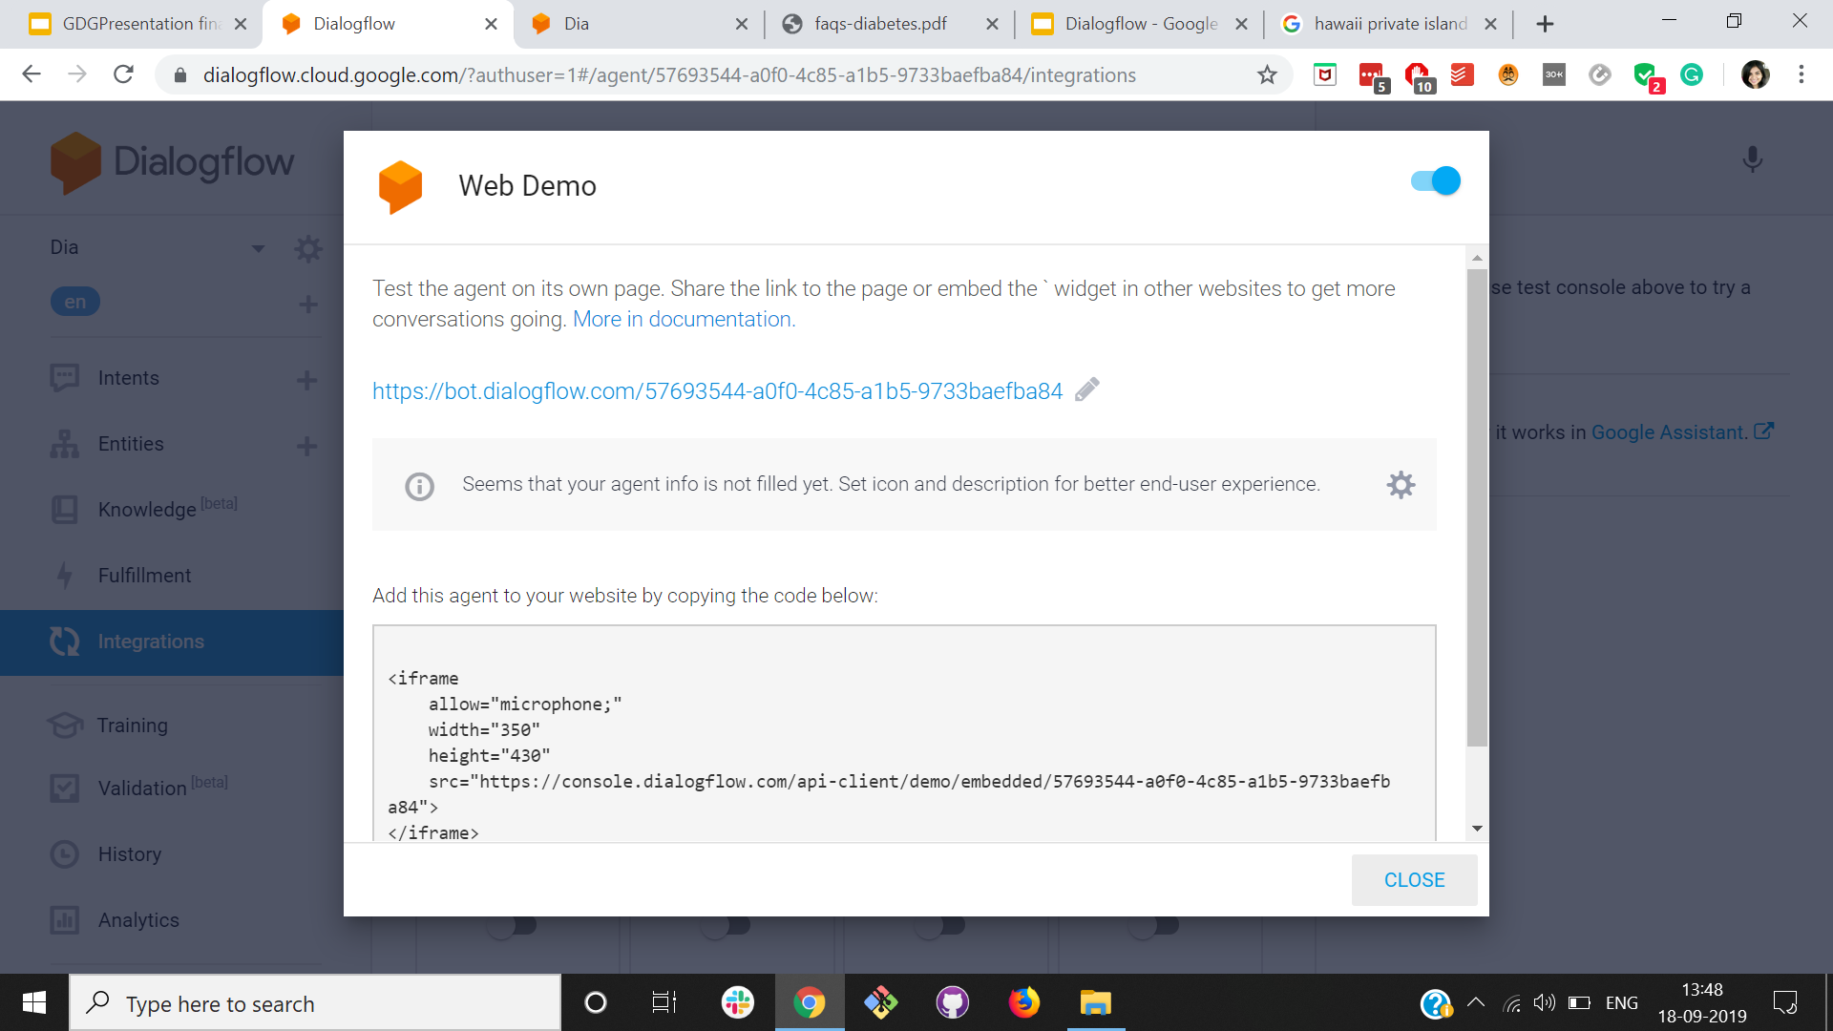

Slide 38
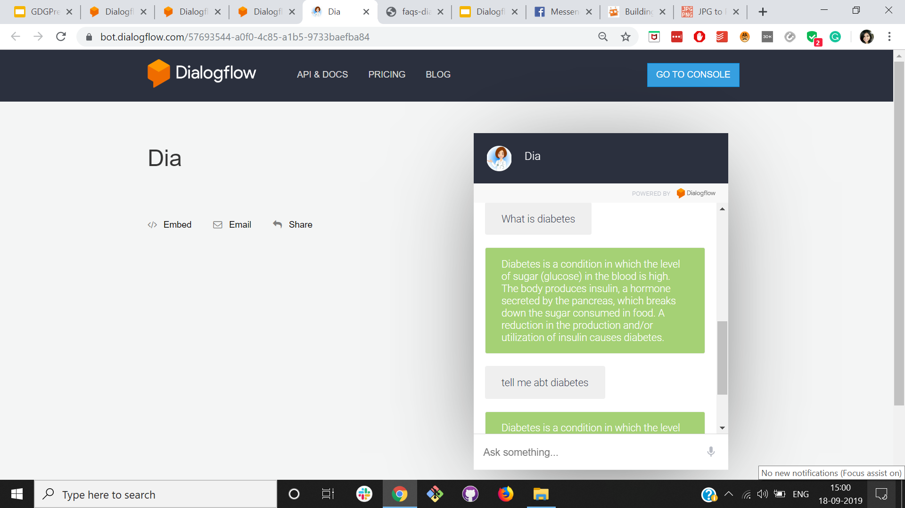

Slide 39
Types of default intent:
Default welcome message
Default fallback message

Slide 40
Default welcome message
User Input.. Response
Hi! I’m Dia, your health partner! You can ask me any questions related to Diabetes and I shall answer you, to the best of my ability
Hey wassup
Hi
Hello
Get started
Hey Dia

Slide 41
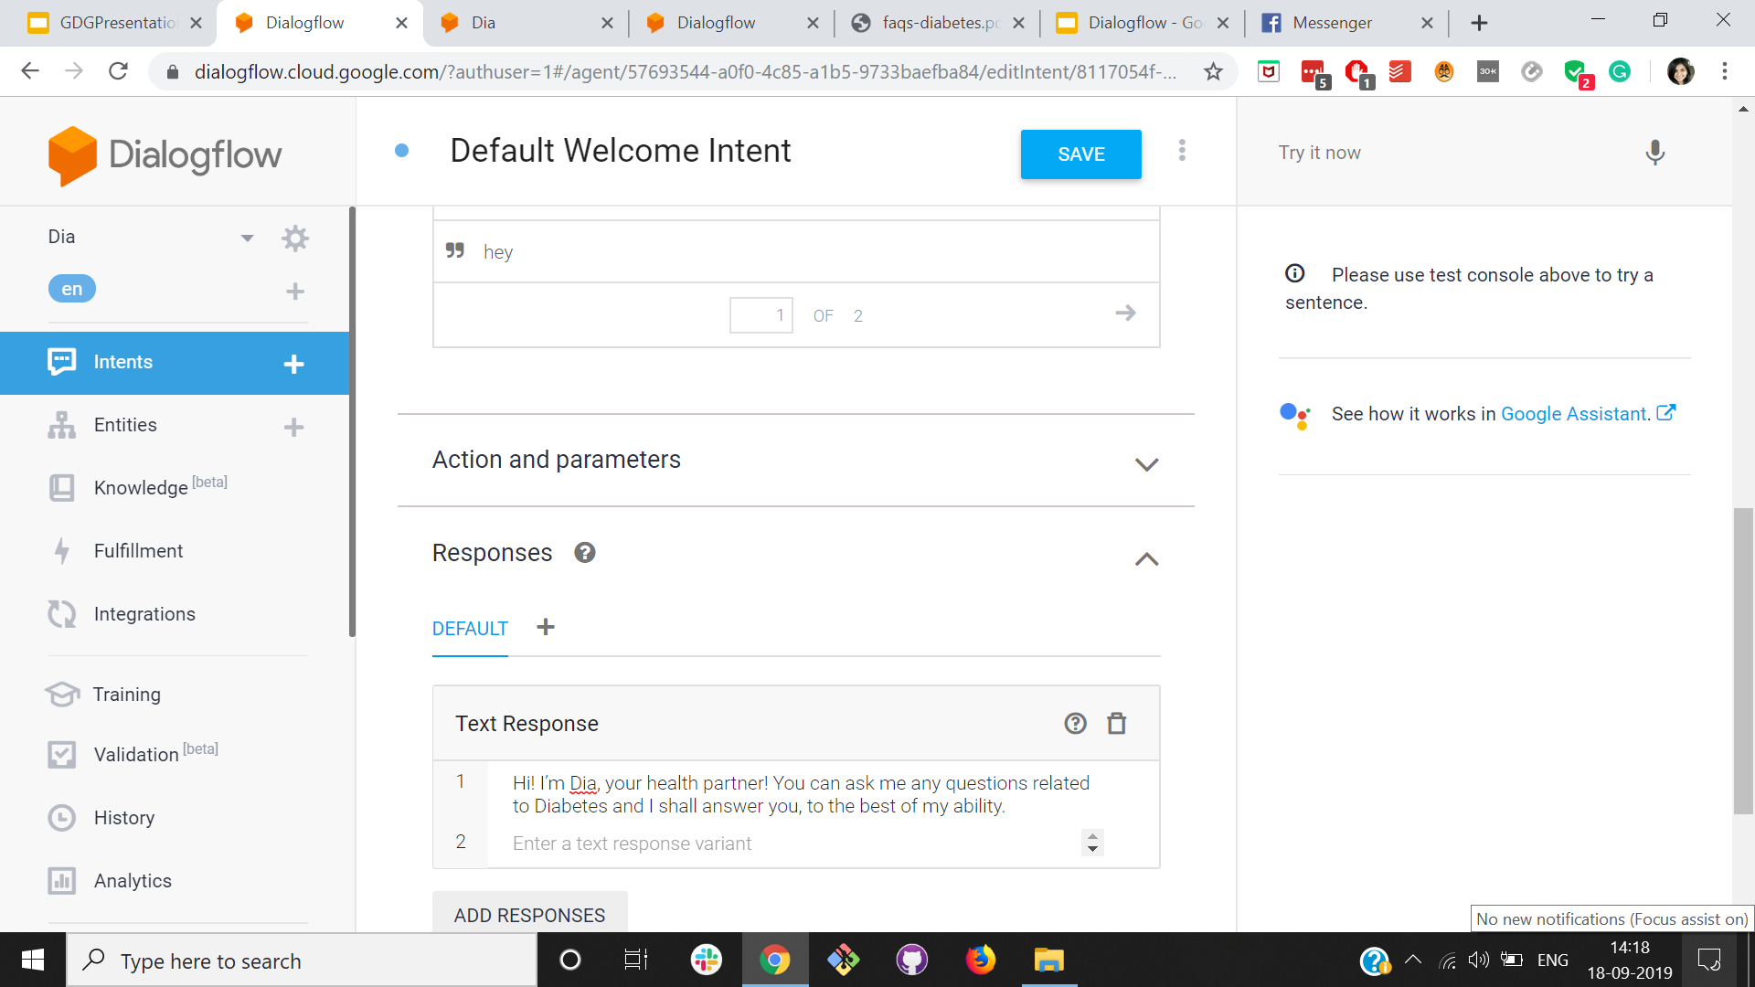

Slide 42
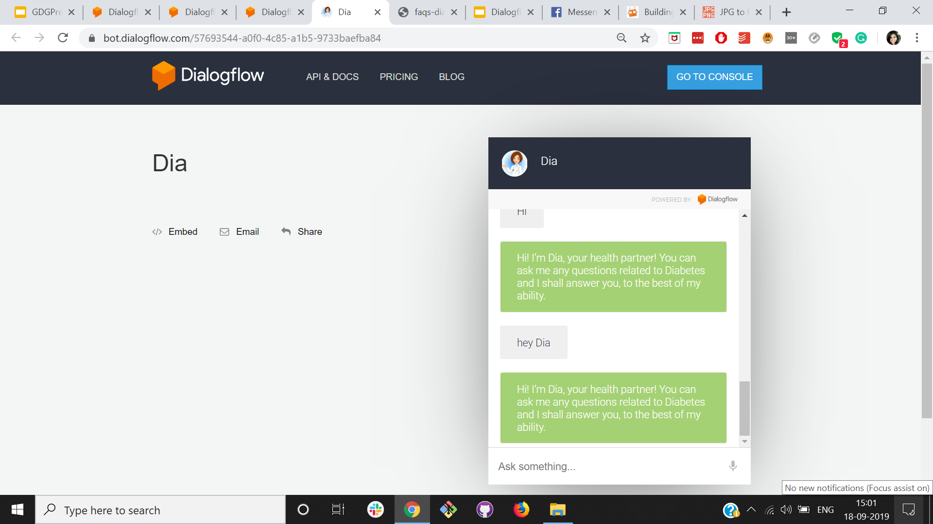

Slide 43
Default fallback message
User Input Response
I’m sorry, I couldn't answer your question. Still, you can go ahead and ask me other questions!
#$^$^^$*&^#
Get lost
What is cancer?
How to cook food?

Slide 44
Queries
 | User query | Intent
1 | What is diabetes? | about.diabetes
2 | What is the recommended veg diet for diabetes? | recommended.veg.diet.diabetes
3 | Can I eat non-veg food if I have diabetes | nonveg.food.diabetes
4 | Can I drink alcohol if I have diabetes? | consume.alcohol.diabetes
5 | What are the steps to a successful talk? | Default Fallback Message

Slide 45
Default fallback message
User Input Response
I’m sorry, I couldn't answer your question. Still, you can go ahead and ask me other questions!
What are the steps to a successful talk?

Slide 46
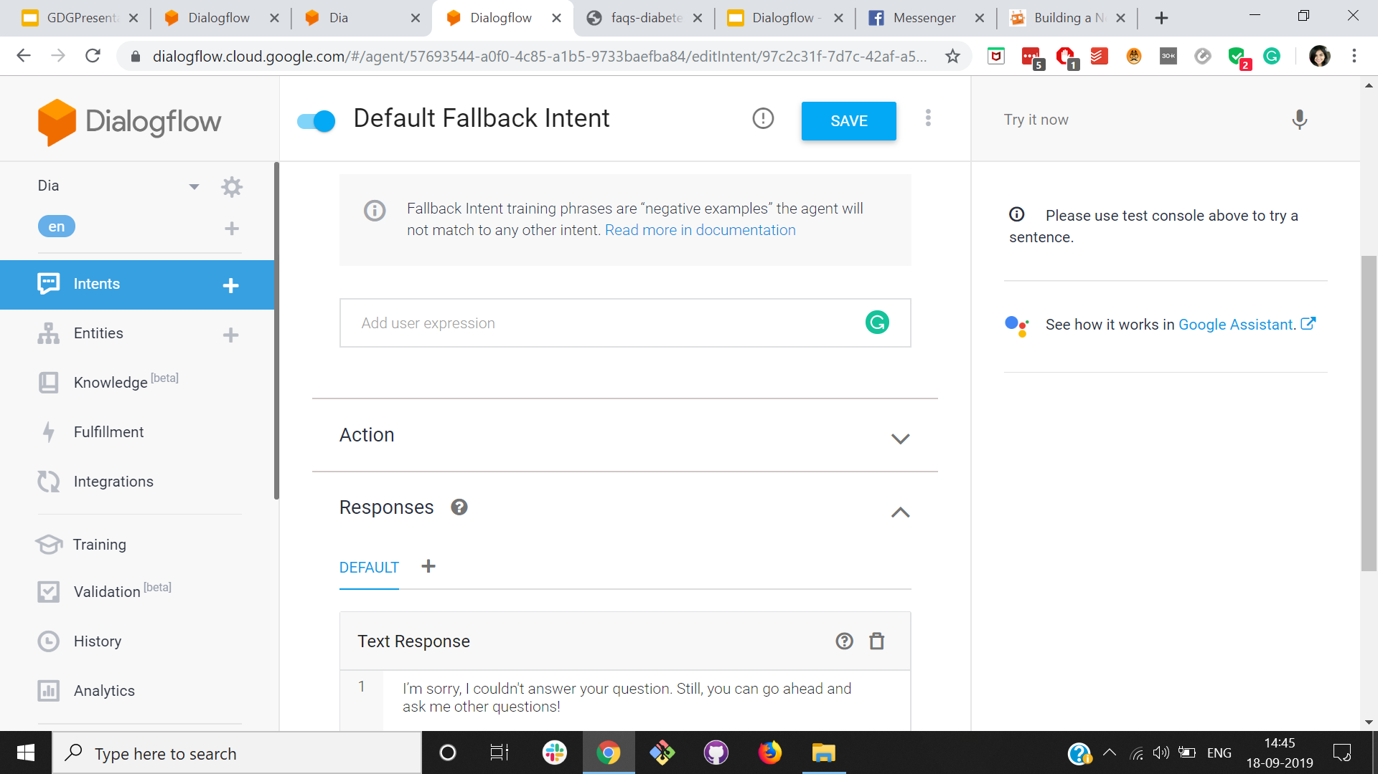

Slide 47
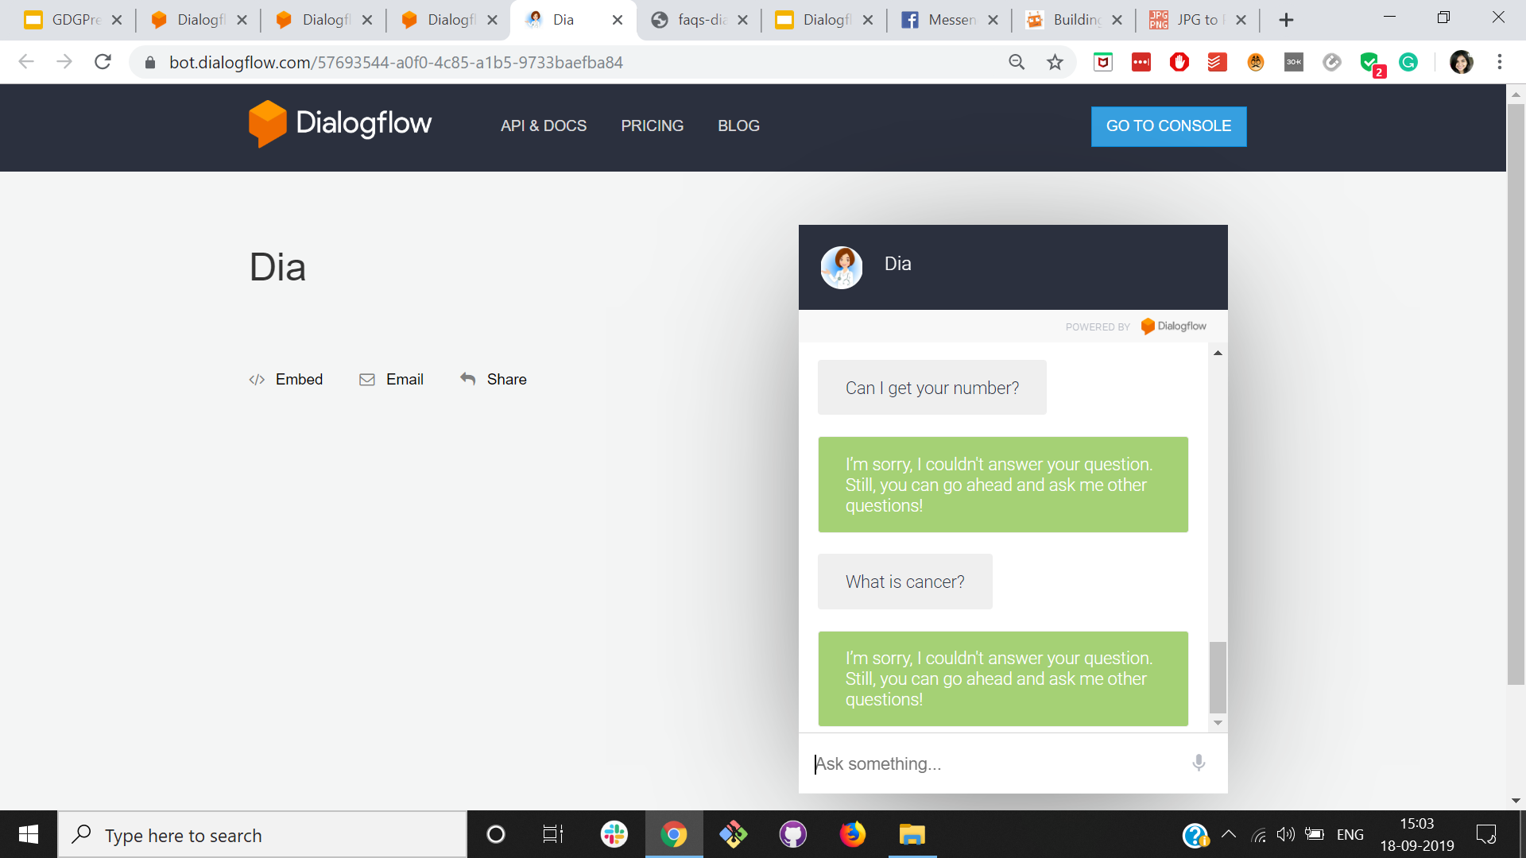

Slide 48
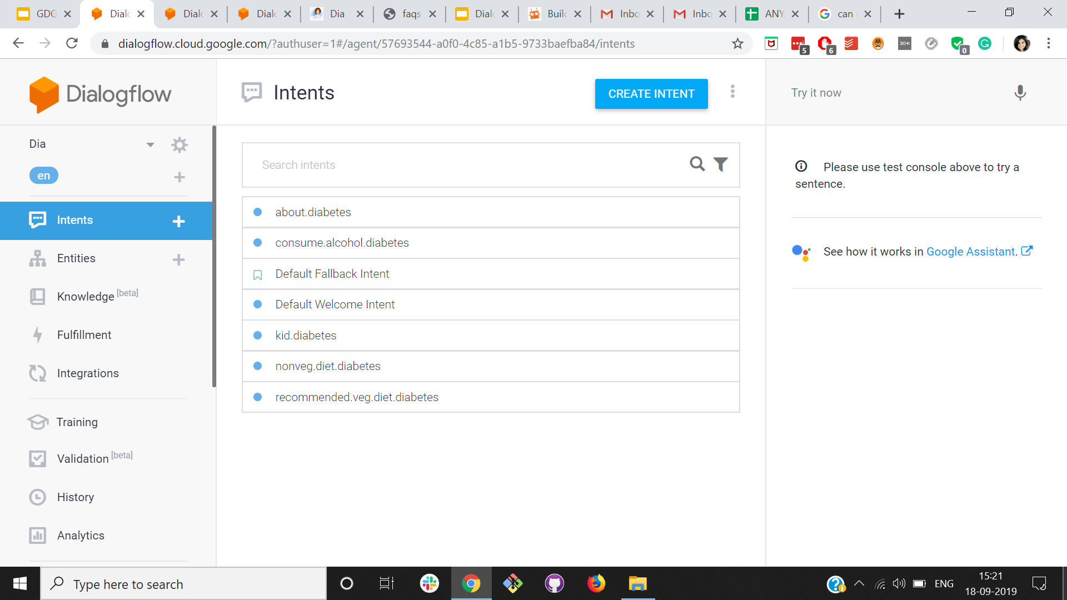
Adding the training phrases
What is diabetes
Hey, tell me abt diabates
Define diabetes
What’s diabates?

Slide 49
What if the user asks...
about.diabetes
recommended.veg.diet.diabetes
Can I have beer if I have diabetes?
nonveg.diet.diabetes
consume.alcohol.diabetes
kid.diabetes

Slide 50
Entities
Use of entities to extract useful facts from what user says.

Slide 51
Entities
Use of entities to extract useful facts from what user says.

Slide 52
Entities
Use of entities to extract useful facts from what user says.
Entities are great in giving personality to a bot.
Notes:
Entities help

Slide 53
Entities
Use of entities to extract useful facts from what user says.
Entities are great in giving personality to a bot.

Slide 54
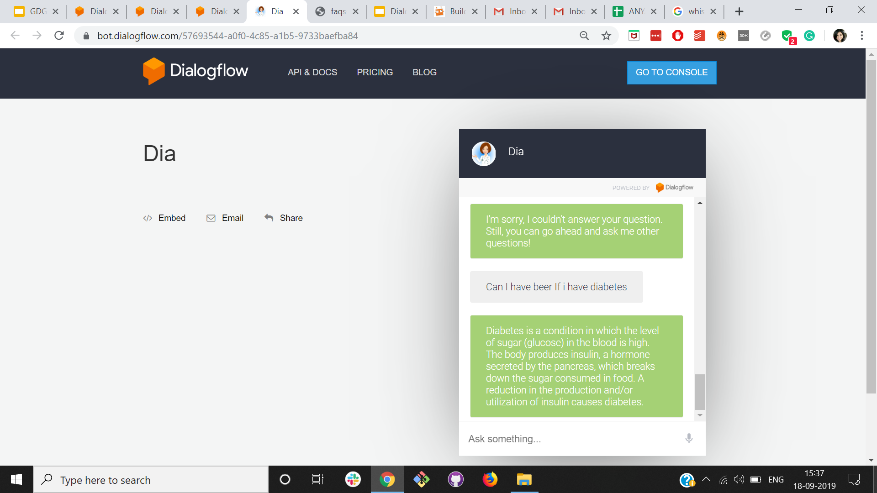

Slide 55
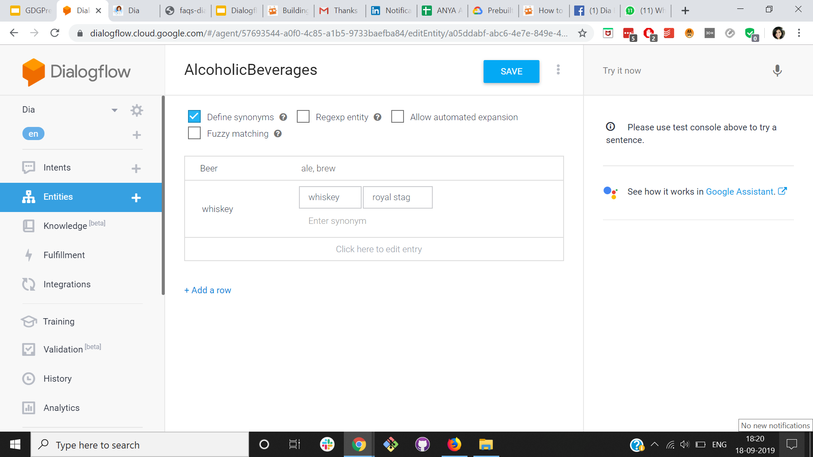

Slide 56
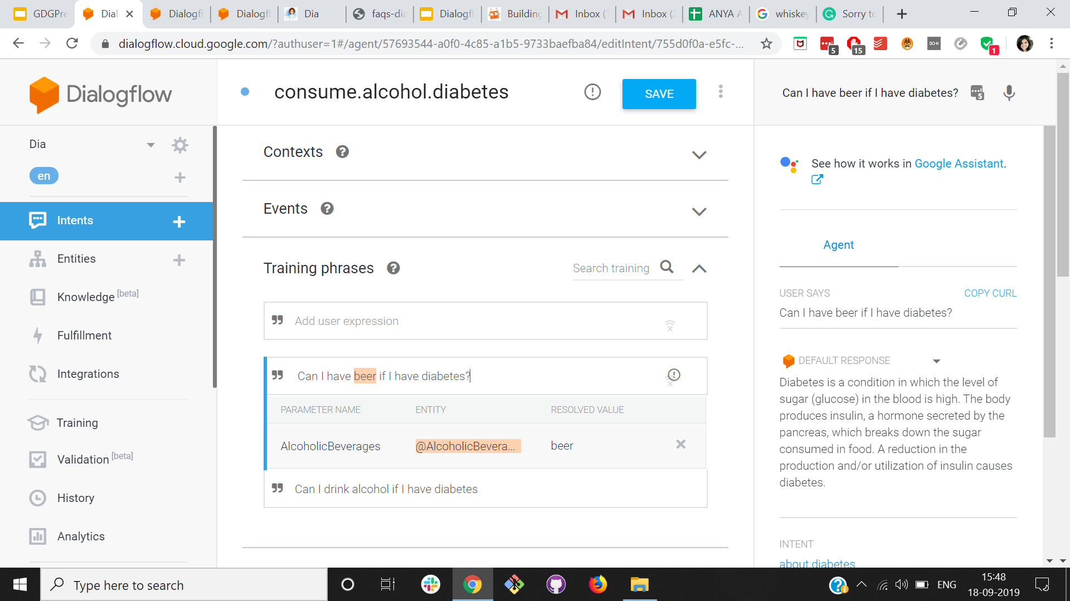

Slide 57
Now when the user asks
recommended.veg.diet.diabetes
about.diabetes
nonveg.diet.diabetes
Can I have beer if I have diabetes?
consume.alcohol.diabetes
kid.diabetes

Slide 58
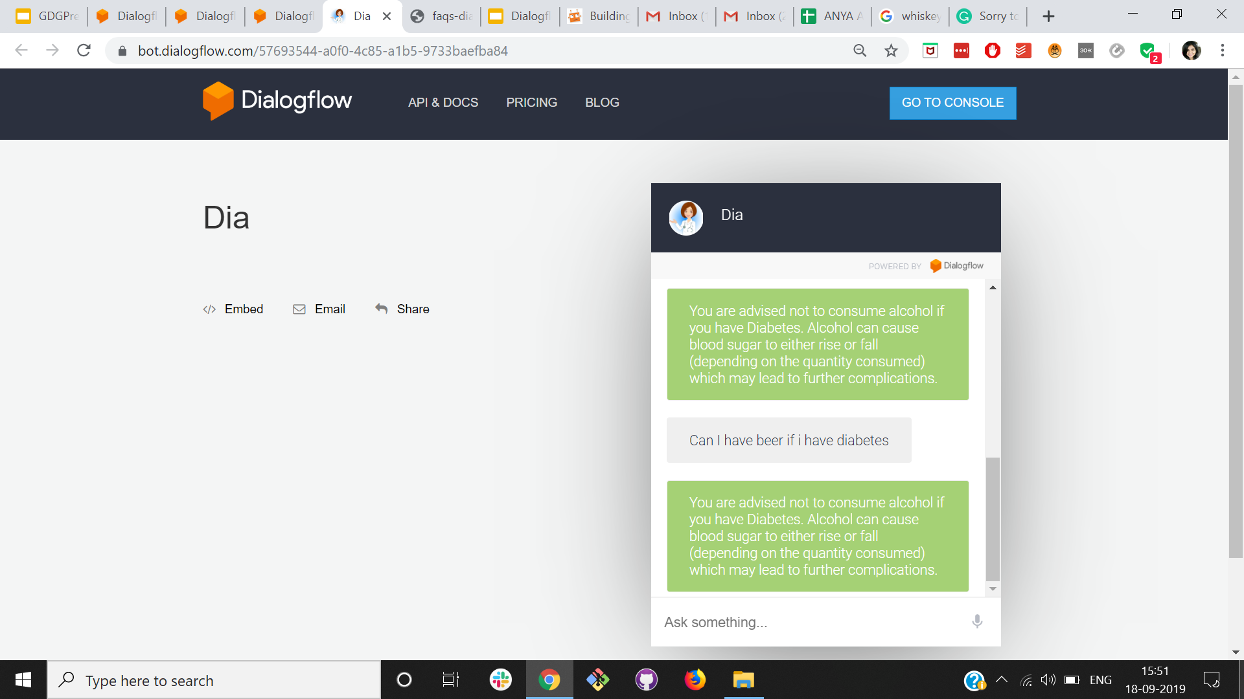

Slide 59
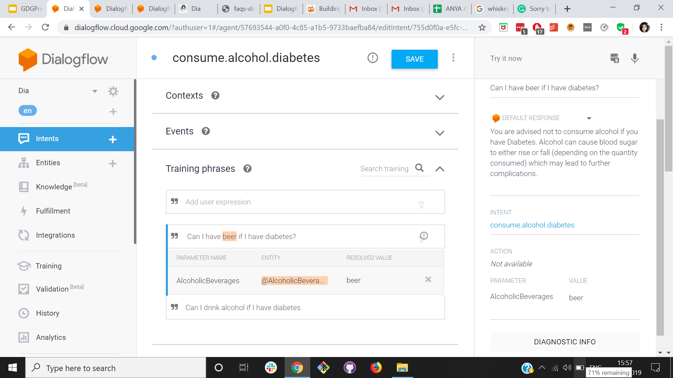
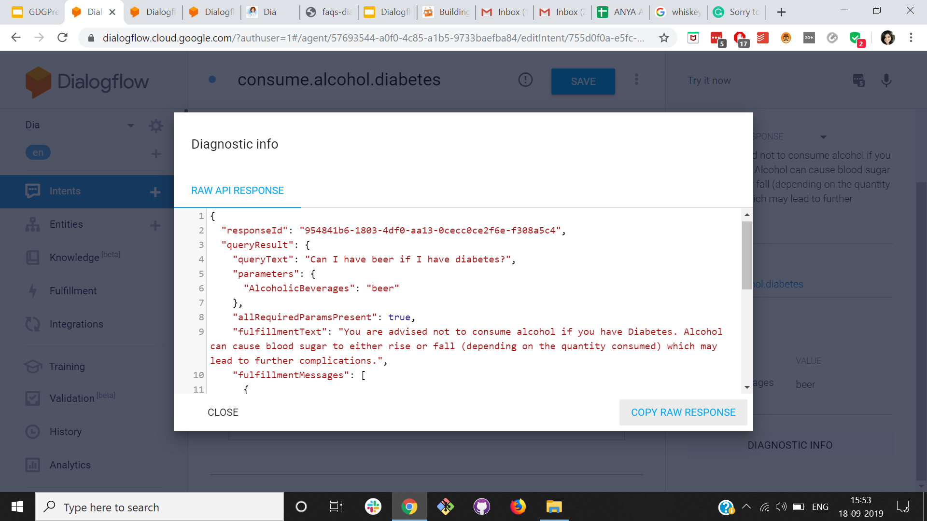
SUMMARY

Slide 60
Entities helps in identifying the
Who
When
Where
In the Natural Language input

Slide 61
Best practices when defining intents
Training phrases should be representative.
Make sure the intents don’t overlap.
Prioritize intents that represent the most common requests.

Slide 62
Small Talk
Pre-built small talk agent.
Customised small responses.
Customised SmallResponses

Slide 63
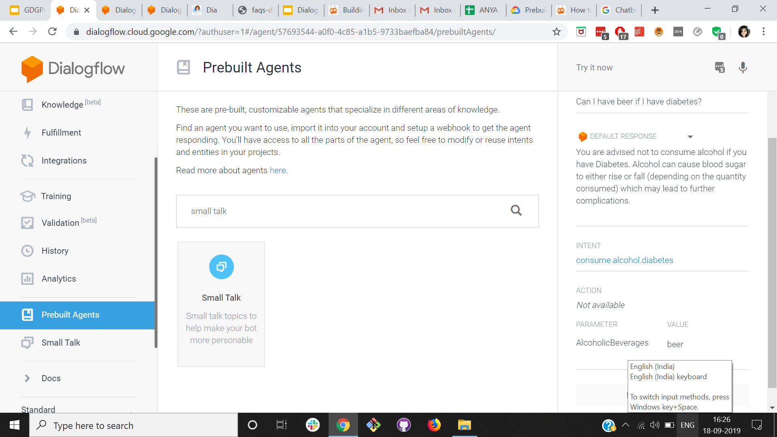

Slide 64
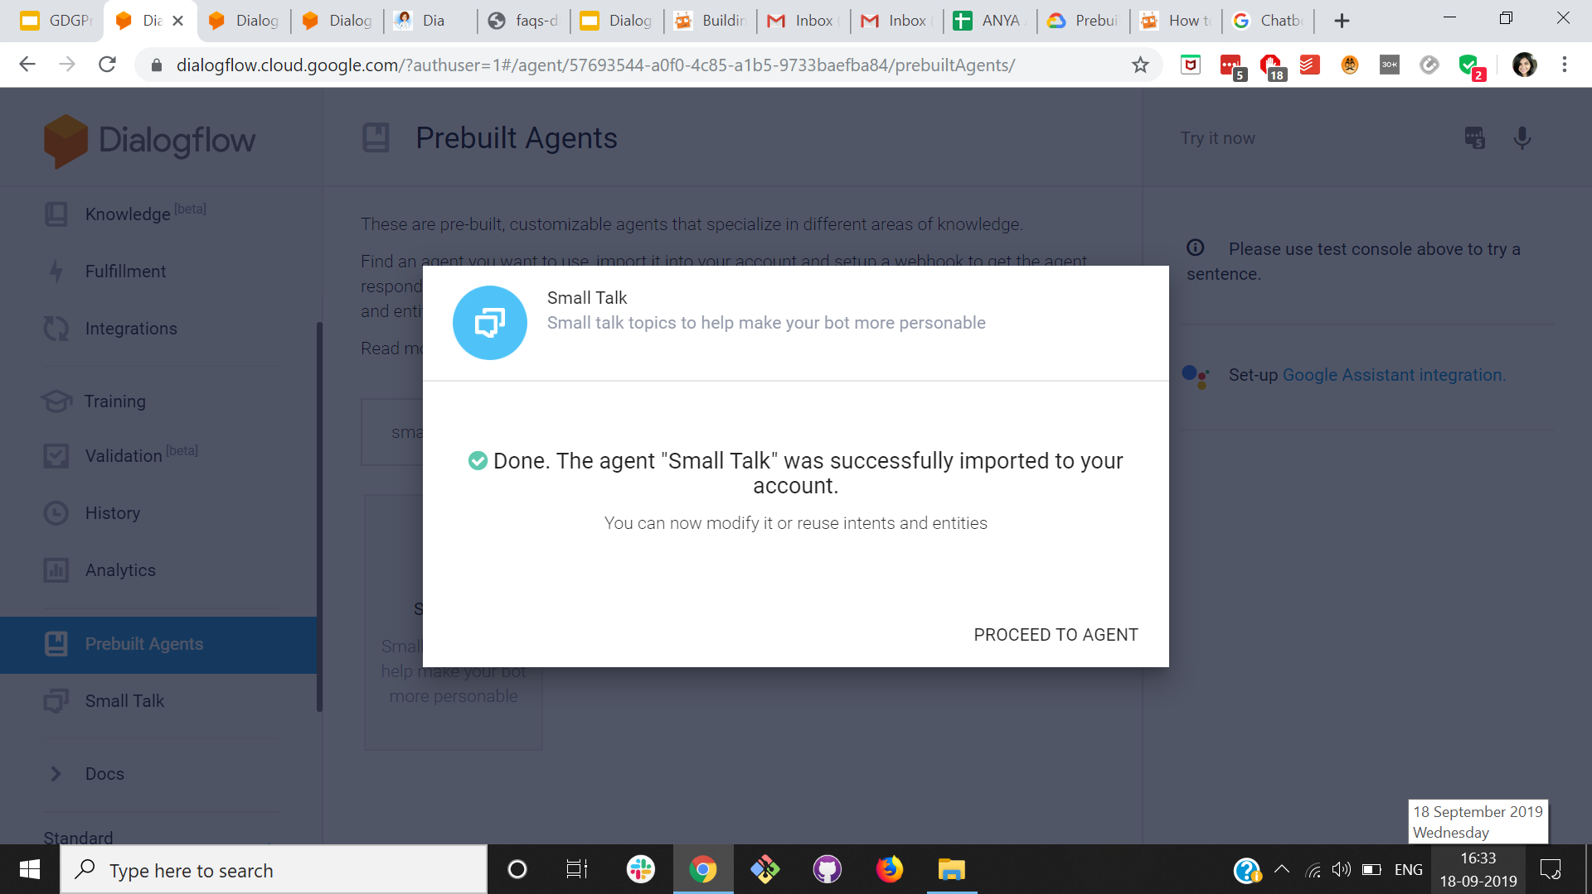
Training

Slide 65
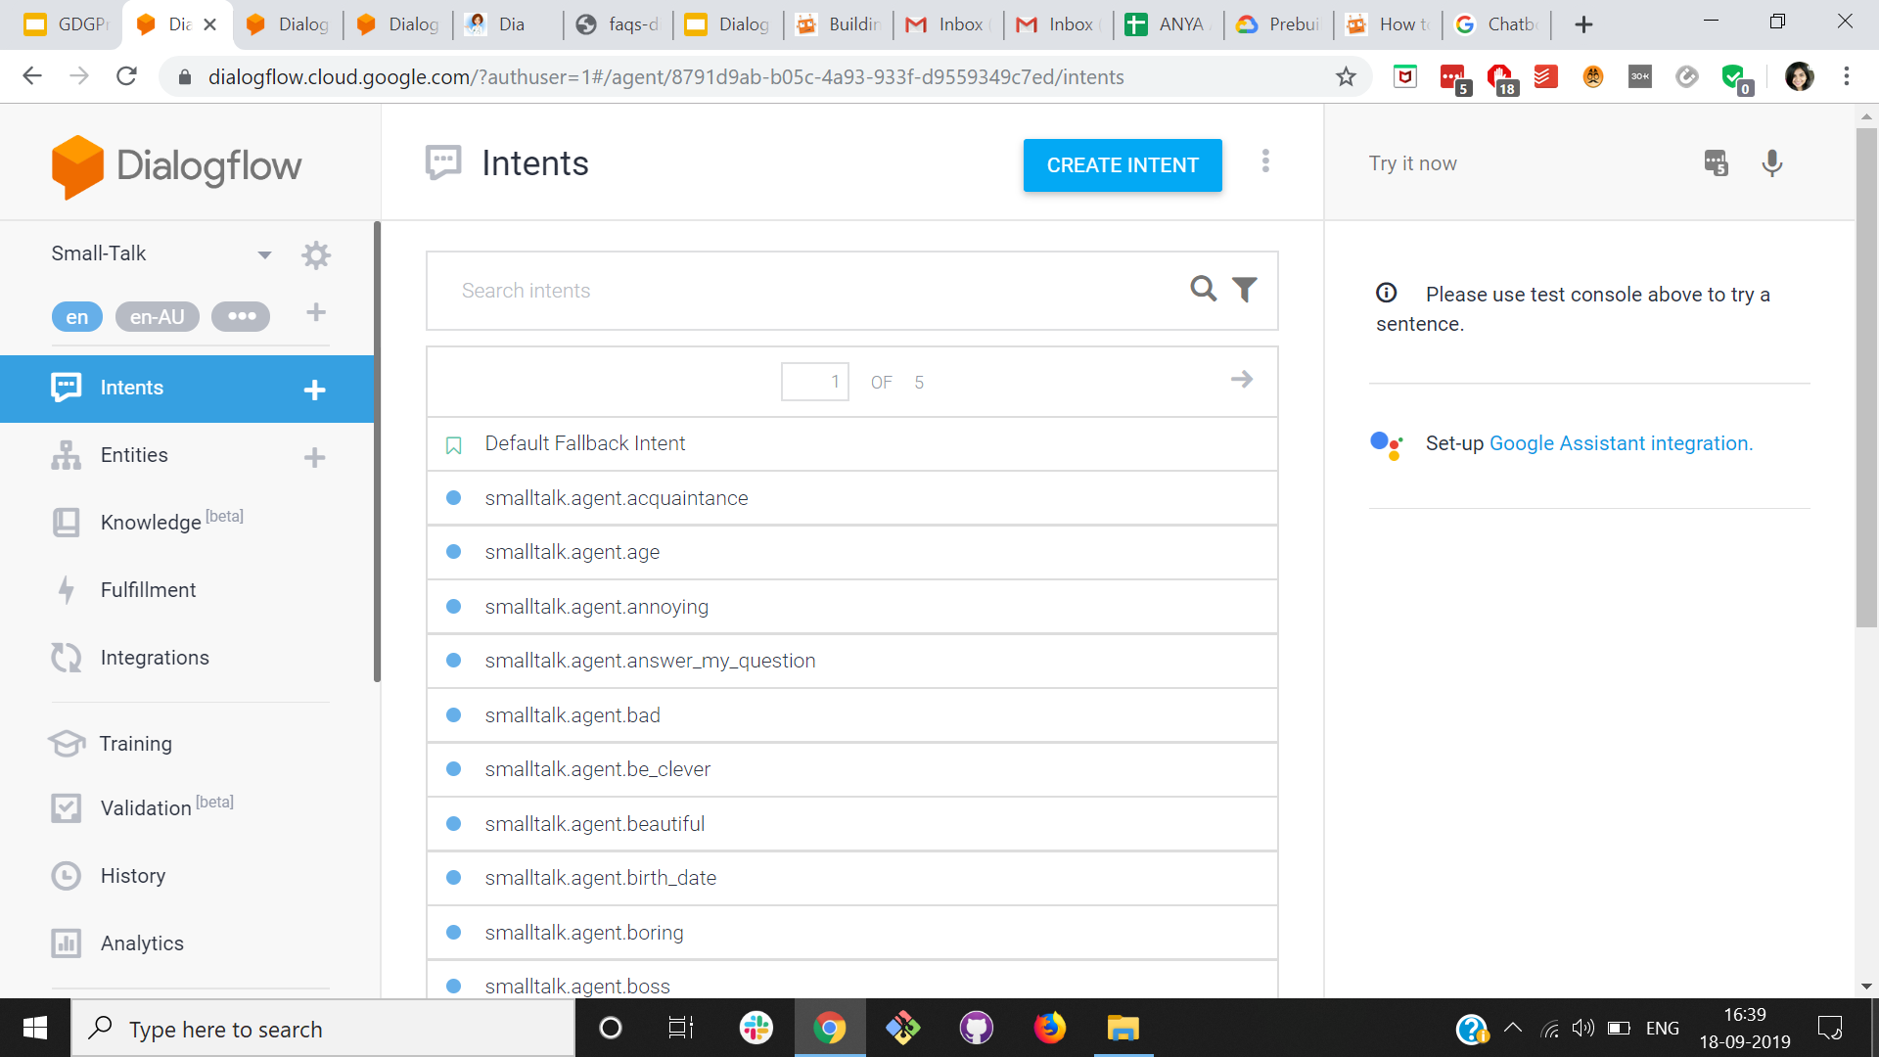
History

Slide 66
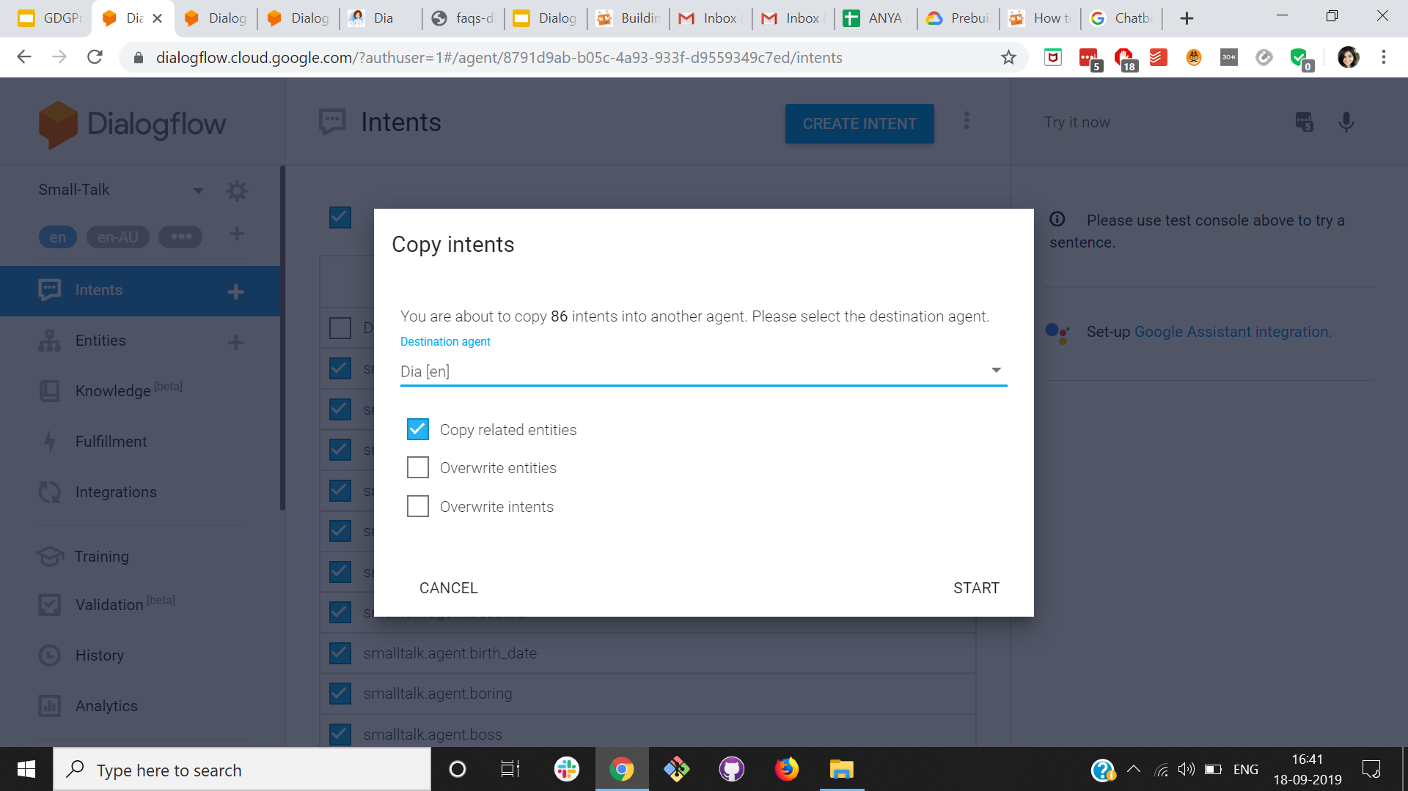

Slide 67
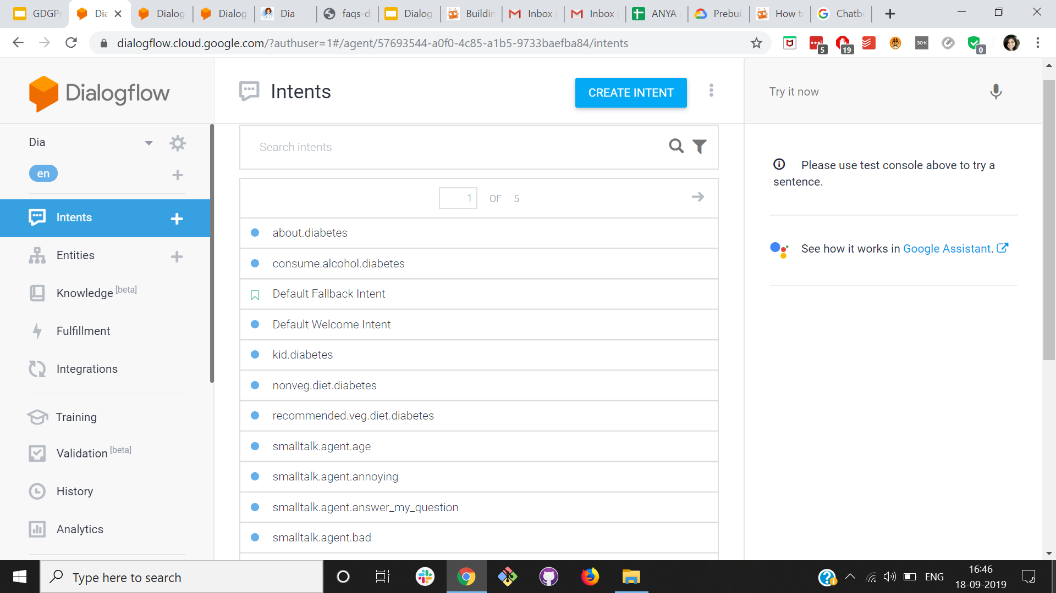

Slide 68
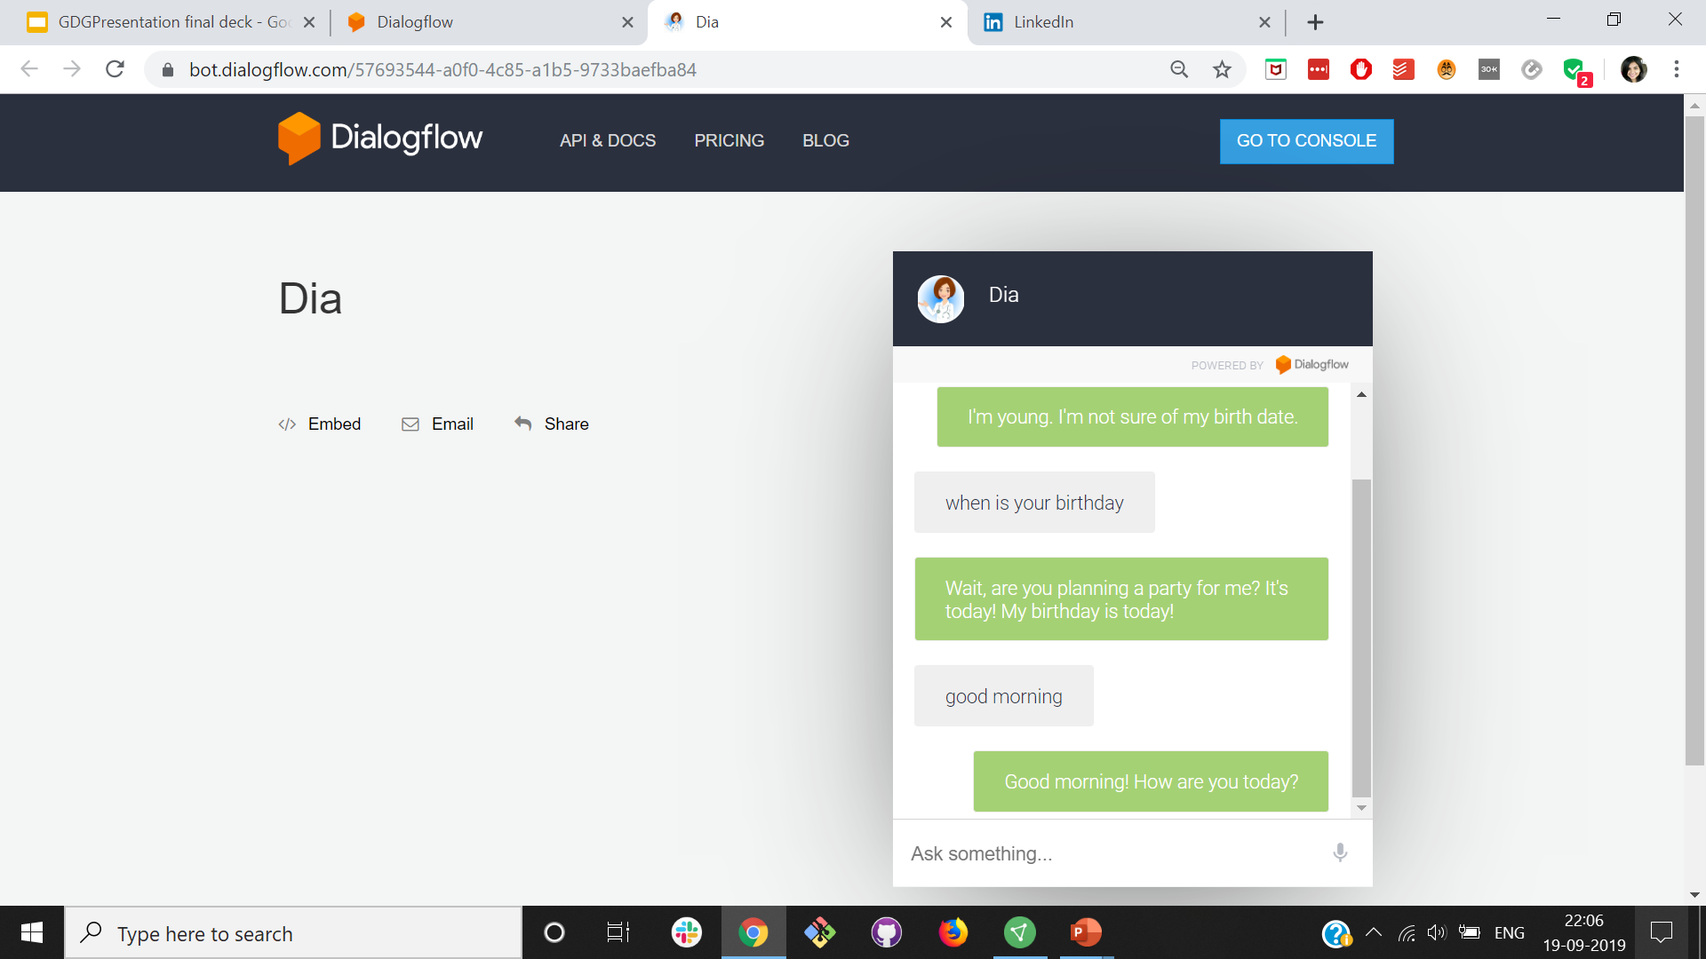

Slide 69
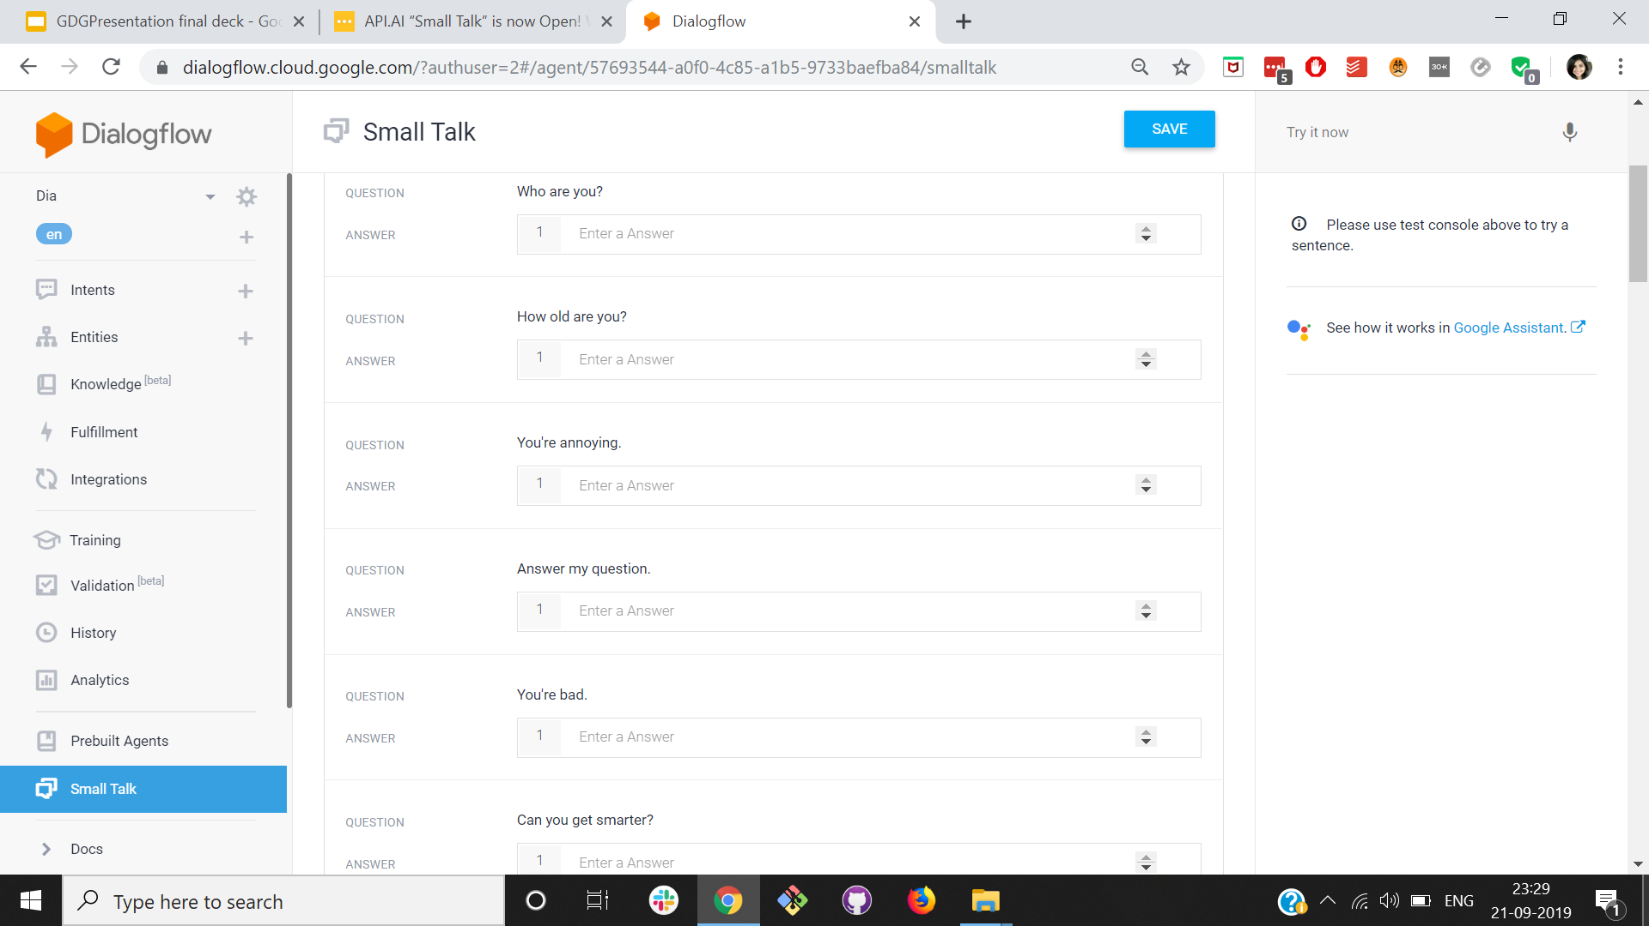

Slide 70
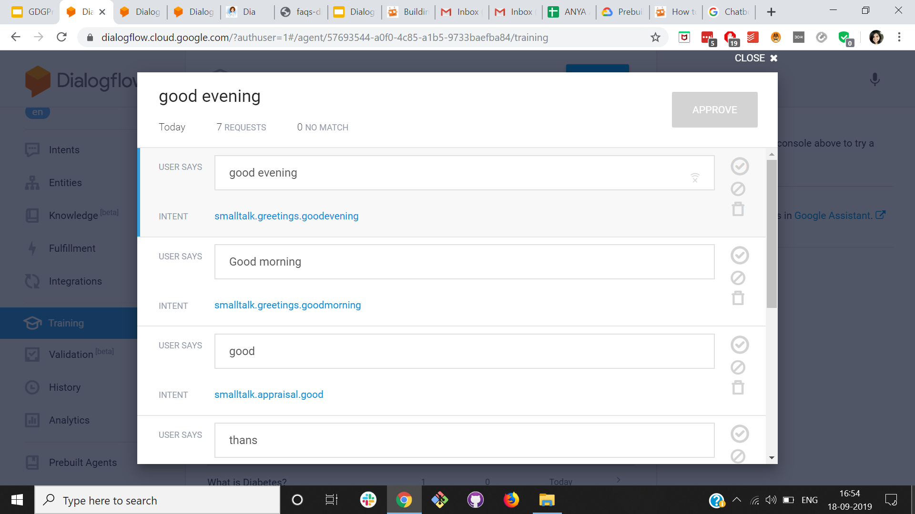

Slide 71
History of conversations

Slide 72
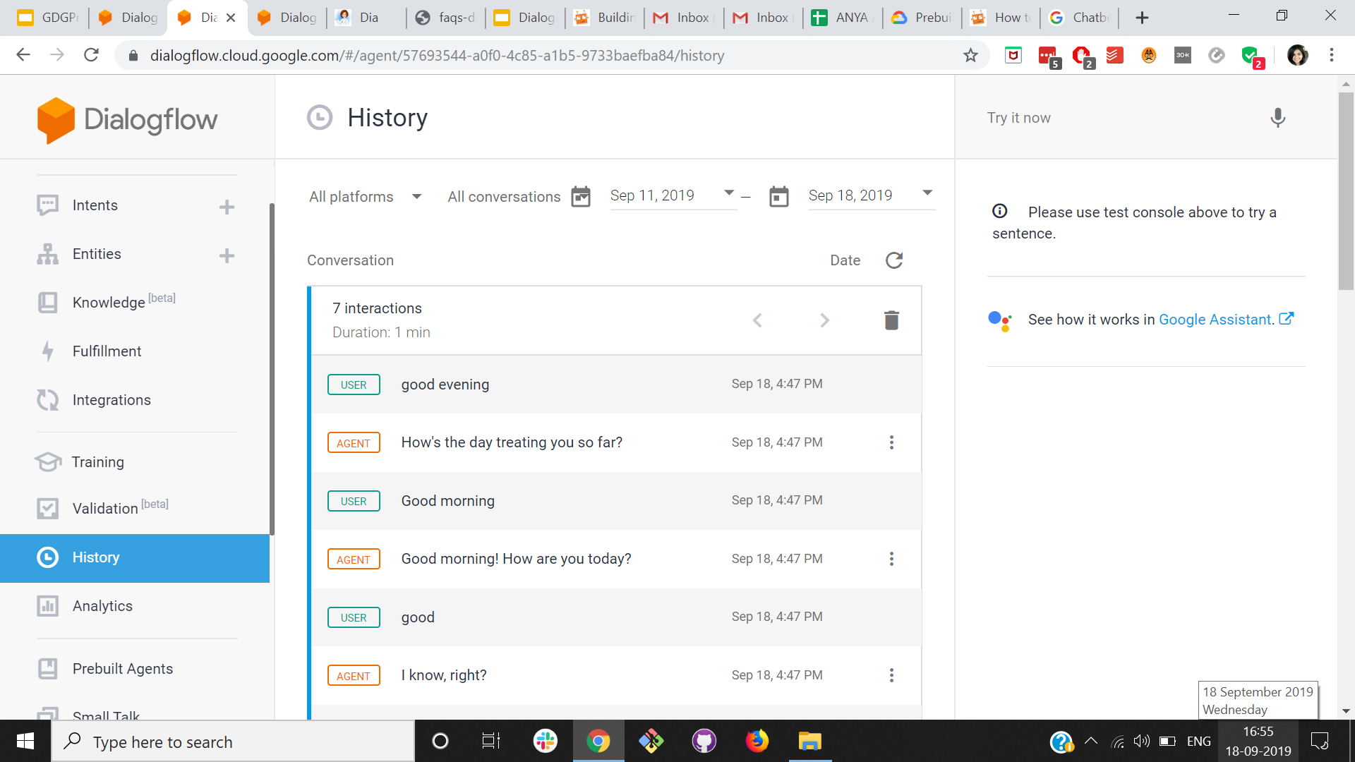
SUMMARY

Slide 73
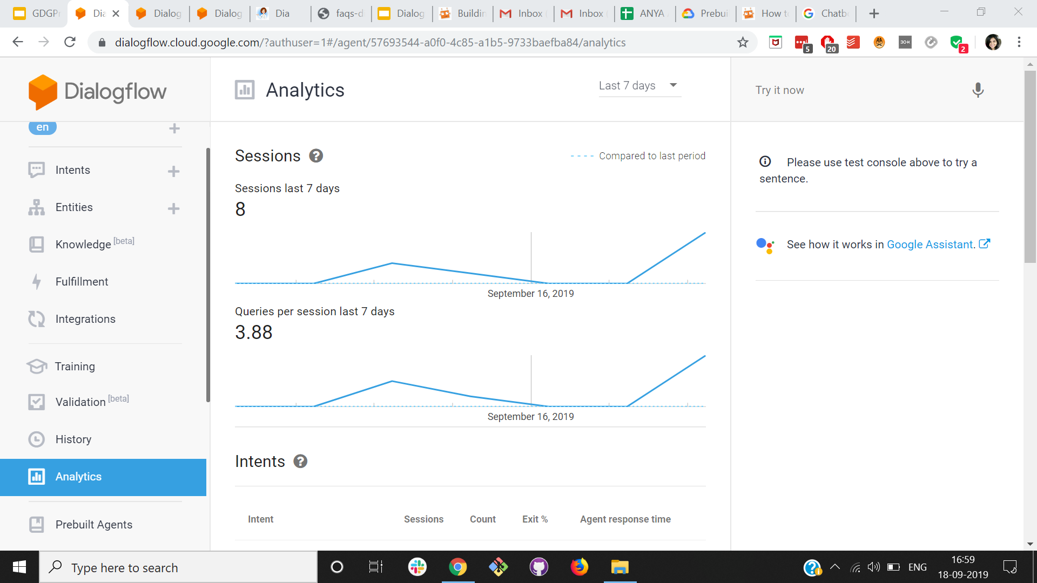

Slide 74
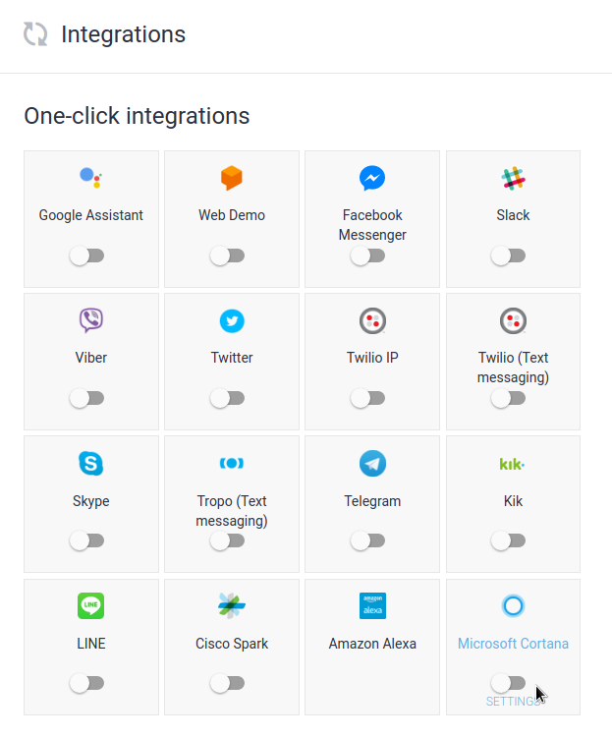
Simple & easy integrations with major platforms
Notes:
We can simply integrate our diagflow agent with any major platform

Slide 75
Workflow of a chatbot (3D’s)
Design - what to build

Slide 76
Workflow of a chatbot (3D’s)
Design - what to build
Develop - how to build

Slide 77
Workflow of a chatbot (3D’s)
Design - what to build
Develop - how to build
Deploy - how to deliver
Notes:
When yo

Slide 78
Talking about design
Bot might say:
Bot should never say:
Does that sound good?
I’ll get back to you later
Does not exist?
Invalid
I did not receive any response
Notes:
Fail gracefully

Slide 79
Conversational design checklist

Slide 80
Greetings and Goodbyes
Introduce, provide information, and end conversations gracefully.

Slide 81
Conversational dialogue
Sound natural.
Be co-operative.
Take turns.

Slide 82
Conversation repair
Prevent errors by expecting variations.
Provide helpful reprompts.
Fail gracefully.
Be prepared to help anytime.

Slide 83
Persona
Stay consistent.
User retention.

Slide 84
Benefits of using Dialogflow
Build faster
Notes:
Dialogflow lets us build bot quickly

Slide 85
Benefits of using Dialogflow
Build faster
Engage more efficiently

Slide 86
Benefits of using Dialogflow
Build Faster
Engage more efficiently
Maximize reach
Notes:
By having an engaging conversation with the user, we can maximize our reach as the users might recommend our bot to others.

Slide 87


Slide 88
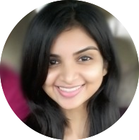


Thank you!
@mitushaarya

